Slide 1
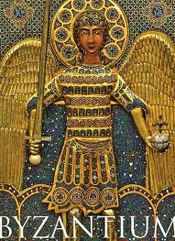
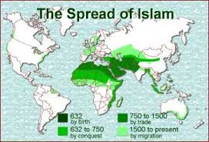
Chapter 9.1 and 10.1
Byzantine Empire and the rise of Islam

Slide 2
The “New Rome”
Constantinople prospers even after Rome falls
Becomes the center of trade
Flourishes under emperor Justinian

Slide 3
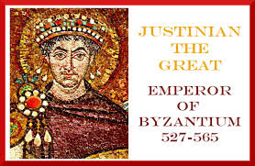
JUSTINIAN
-ruled 527-565AD
-rebuilt Constantinople with glorius buildings
-revised and organized Roman laws into Justinian’s Code
-basis for modern law

Slide 4
10.1 Rise of Islam
Muhammad became the “messenger of God”

Slide 5
The Five Pillars of Islam
-duties that must be performed by all Muslims (pg. 307)
Home of Islam is Mecca, in the Arabian Peninsula
Quran – the sacred text
Taught people that God is all powerful, compassionate and that people are responsible for their own actions.
-Islam is a religion and way of life
-Sharia – laws based on the Quran
*influences
-moral conduct
-family life
-government
-business practices

