Slide 1
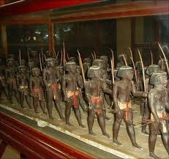
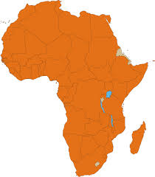
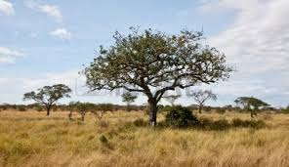
Chapter 11
Kingdoms of Africa

Slide 2
African Geography
-near equator is rain forest
-savannas (grasslands) to the north and south of that
-far north is the Sahara Desert
-wealthy with natural resources (salt, gold, iron, copper)
-early people traveled by camel caravans

Slide 3
The Sahara Desert
-up to 2500BC, the Sahara had water
-climate change led to desertification (land dried out and became desert)
-this led to the Bantu Migrations
-2000 year period when northern Africans moved south and east to farm
-spread culture and skills

