Slide 1
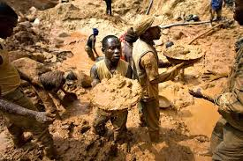
Section 2 Kingdoms of West Africa

Slide 2
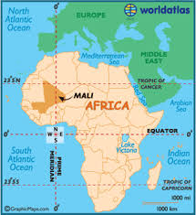
Trade grows
Mansa Musa (leader of Mali)
GOLD and SALT
These were important commodities (valuable products)
-Ghana was the first trading kingdom in the West. (land of gold)
-Mali was the 2nd kingdom
-both of these spread Islam and learning
Crash Course!

Slide 3
Salt, why salt?
You need salt to live.
We lose salt when we sweat.
It’s hot in Africa.
Therefore, they sweat and lose salt.
Without it, they die.

Slide 4
The Salt Trade
Africans were willing to trade 1 pound of gold for 1 pound of salt.
Arabians were willing to trade 1 pound of salt for 1 pound of gold.
Both sides were happy!

Slide 5
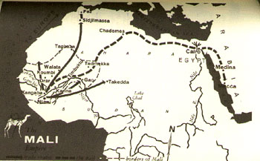
Salt
Excuse me, may I buy some cheap salt?
Big Desert
I will trade my valuable salt for your “worthless” gold!
Gold

Slide 6
Now Complete the Following:
DO QUESTIONS 1-8, 14 and 15
Do questions 1-8, 14 and 15
http://yourhistorDO QUESTIONS 1-8, 14 and 15
yteacher.com/Chapter_5_6/Scavenger.html
http://yourhistoryteacher.com/Chapter_5_6/Scavenger.html

