Slide 1
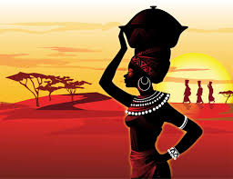
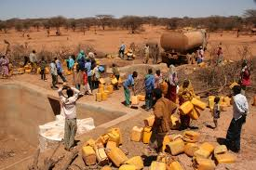
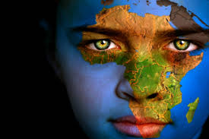
Section 3
Kingdoms of East Africa

Slide 2
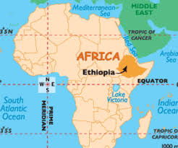
Ethiopia
-modern country in East Africa
-protected/isolated from others by mountains
-adopted Christianity, unique culture for the region
Many East African port cities flourished from trade with Asia

