Slide 1
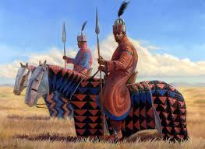
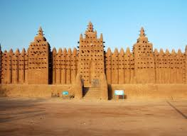
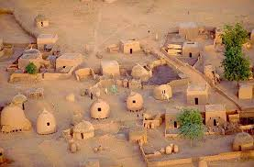
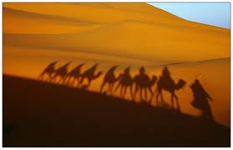
Section 4 Medieval Africa

Slide 2
Formation of Clans
-as people married, families joined
-formed a Lineage – people with common ancestors
-Many lineages = a clan
-gave people a sense of community
-shared responsibilities
-roles determined by age grade (everyone born in same year)

Slide 3
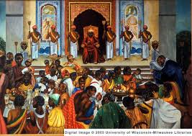
Government
-power was usually shared by a small group rather than one leader
-consensus – agreement of the majority
ART AND LITERATURE
Created much artwork (pottery, jewelry, cloth)
It often identified clans
Written records remain from this time

Slide 4
Oral History
Most African groups did not write down their histories.
Instead, story-tellers called griots would memorize the stories and tell them back to people.
Their job specifically was to keep track of family stories.

Slide 5
Now Complete the Following:
Answer Questions #9, 10, 27-32
http://yourhistoryteacher.com/Chapter_5_6/Scavenger.html

