Slide 1

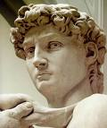


The Renaissance and Reformation 1300-1650
Chapter 13 Page 408

Slide 2
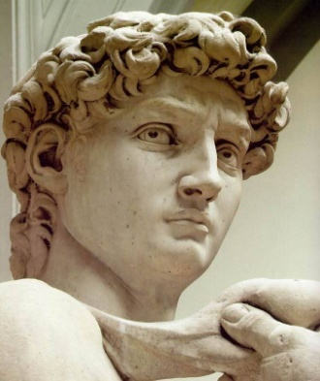
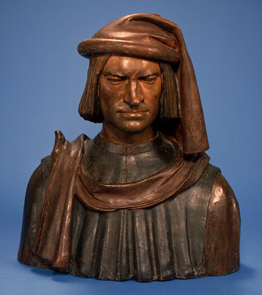
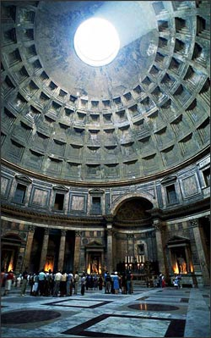
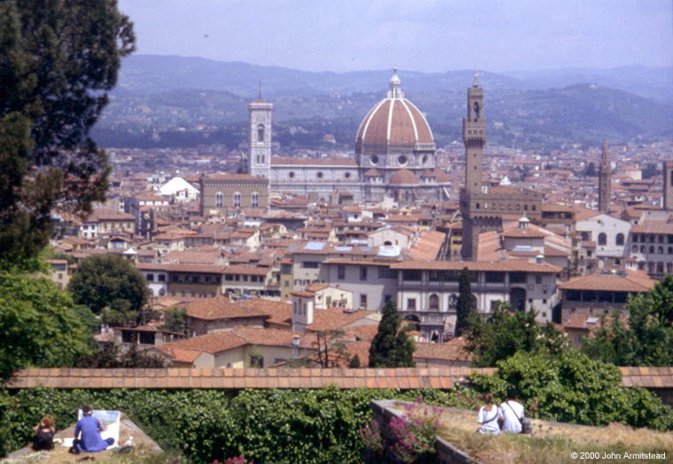
Renaissance
rebirth of art and learning between 1300-1600 in Europe
emphasis on individual achievement
stressed education
return to learning of ancient Greece and Rome (study by humanists)
begins with wealthy merchants in Italy (center of trade)
became patrons – financial supporters
everyone expected to create art

Slide 3
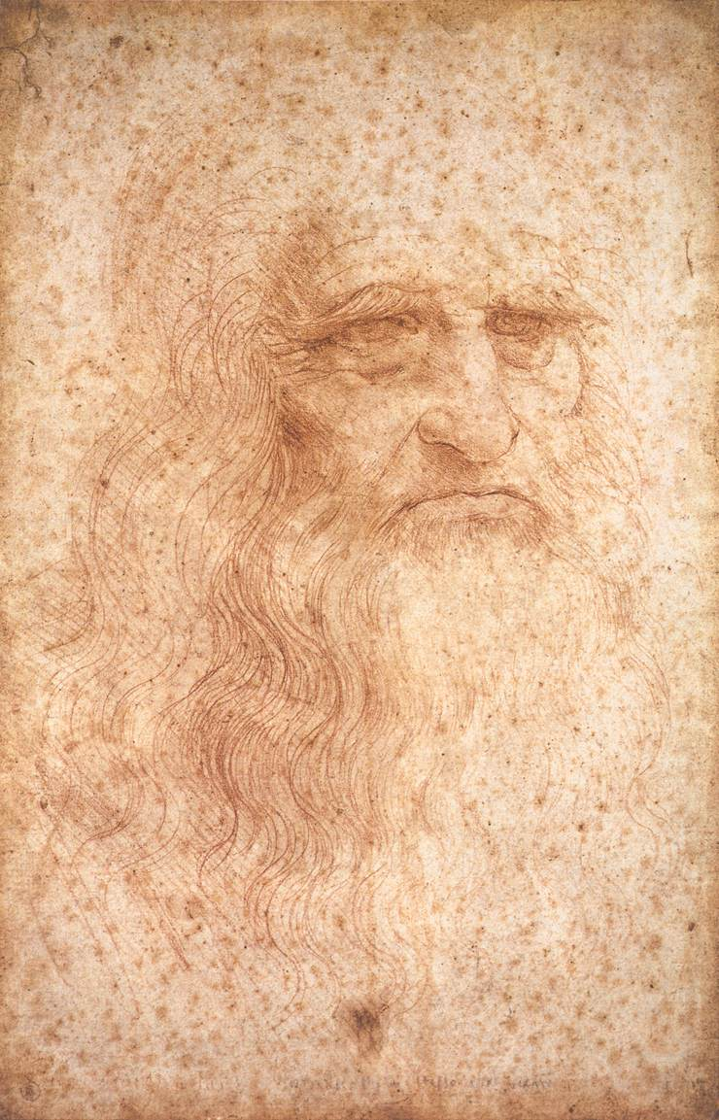
The Renaissance “Man”
Broad knowledge about many things in different fields.
Deep knowledge/skill in one area.
Able to link information from different areas/disciplines and create new knowledge.
The Greek ideal of the “well-rounded man” was at the heart of Renaissance education.
Art was more realistic (painting, sculpting, drawing, writing, acting,
architecture)

Slide 4
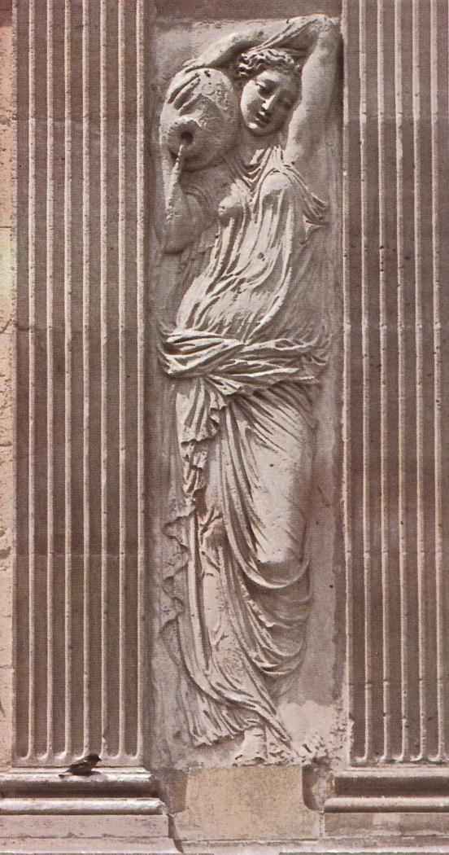
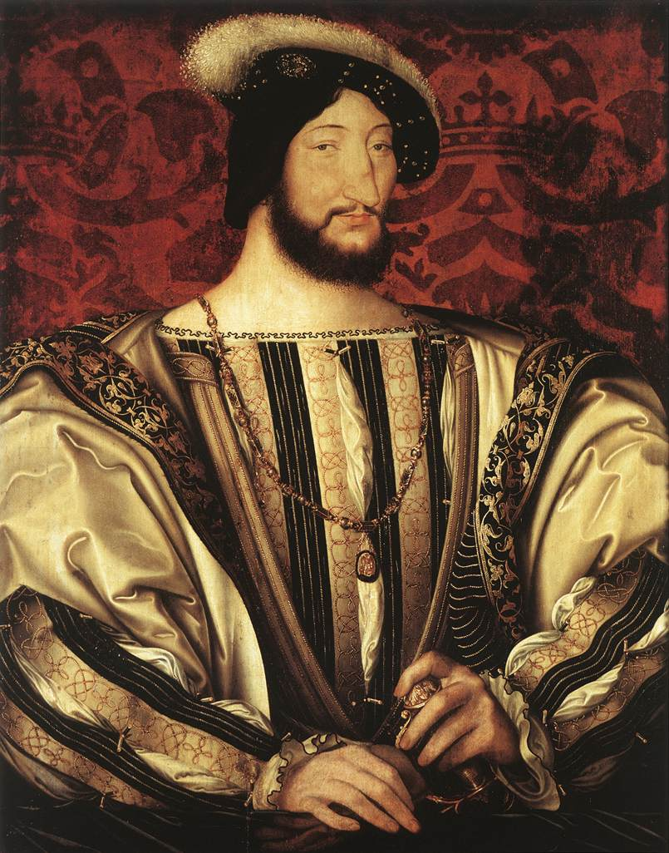
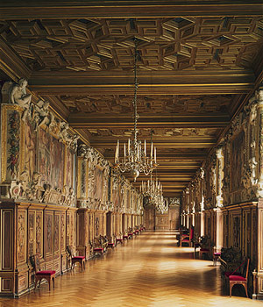
The Northern Renaissance
Section 2 Page 418

Slide 5

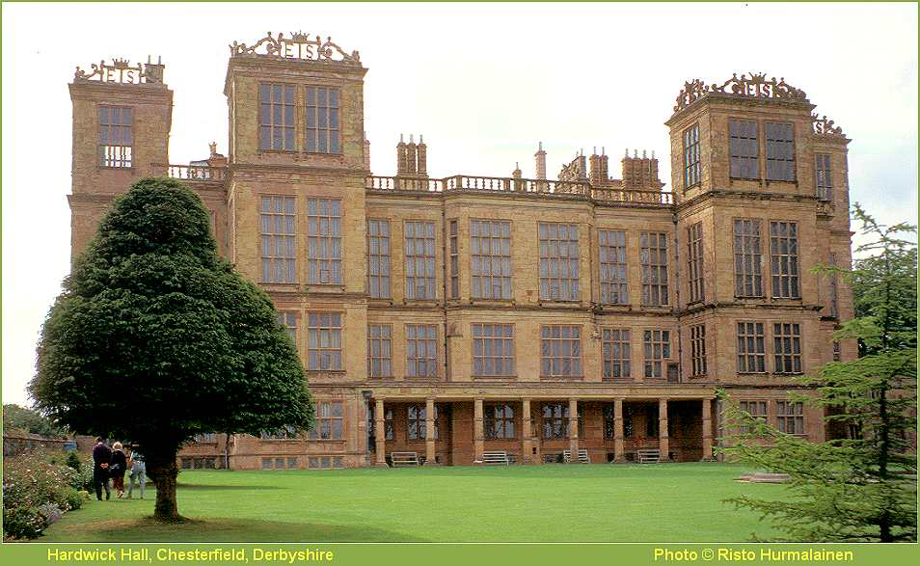
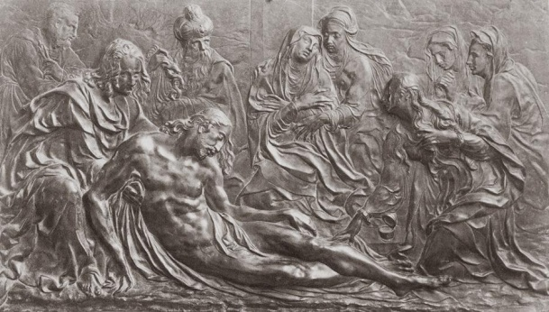
Renaissance ideas spread to the north due to:
cheaper and easier to make books
printed in the vernacular – common language, not Latin
more knowledge available to all social classes
artists wanted to get away from this and brought their artistic ideas with them
1. invention of the printing press by Johan Gutenberg
2. wars in Italy

Slide 6
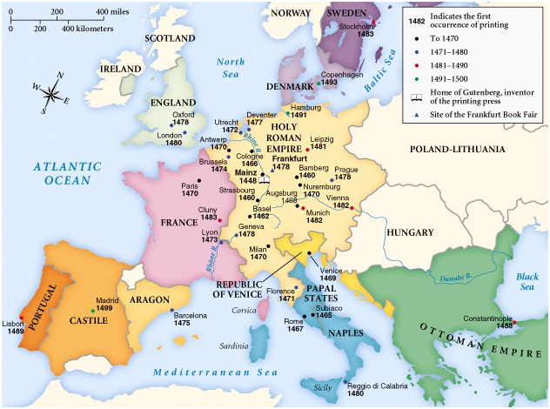
The Spread of the Printing Press

Slide 7

other writers discussed social reforms (open minded government, stopping criminals, helping others, creating a utopia – perfect society)
time period of William Shakespeare – famous writer of plays from England

Slide 8
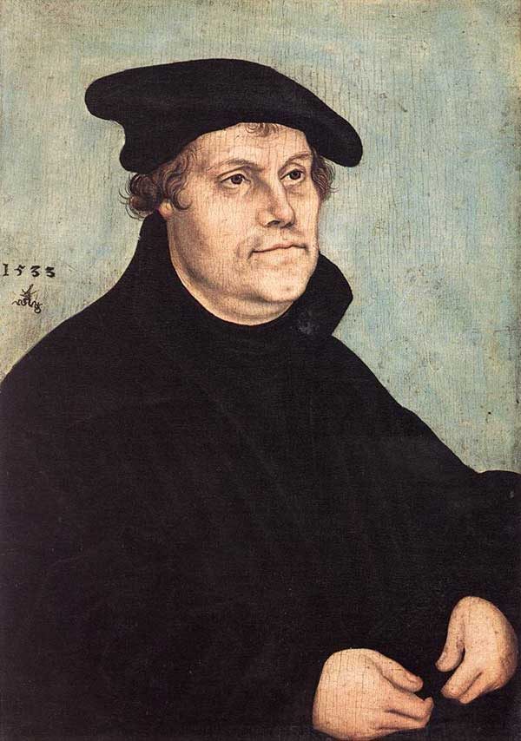
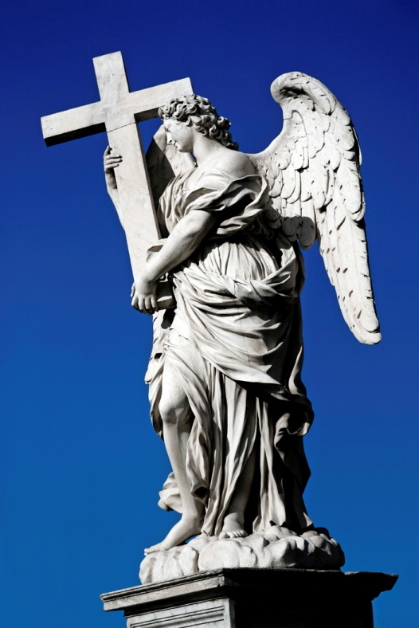
Section 3 Page 423
The Protestant Reformation

Slide 9
Renaissance ideas lead to religious changes
some people begin to question the church and its practices
some clergy leaders were corrupt and not serving the people properly
sold indulgences – reduced penalty or pardon from sins
supposed to be earned, not bought
rich people could buy their way into heaven and behave however they wanted

Slide 10


95 theses – list of problems with the church and its leaders
Reformation begins when Martin Luther writes the:
posts the list on door to a church for everyone to read
ideas spread all over Europe
pope is outraged and excommunicates Luther and states that nobody can give him food or shelter and all of his writings must be burned (Edict of Worms)

Slide 11
Many people agree with Luther and they start their own religion (Lutherans)
this was a group of Protestants – Christians that were not Catholic (protested against the Catholic church)
many disagreements and revolts occur over religion, finally settled by the
Peace of Augsburg – stated that the leader of each territory could decide if they would be Catholic or Protestant

Slide 12
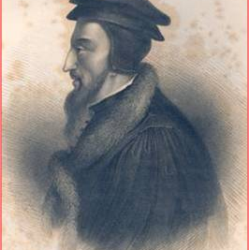
many other protestant groups also gain power including:
Calvinists – led by John Calvin in Switzerland
-said that humans were sinful by nature
-predestination – determined whether you will go to heaven when you were born
-used a theocracy – government ruled by religious officials

Slide 13
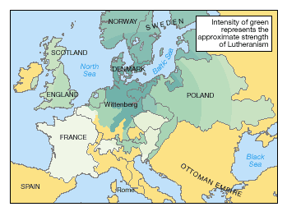
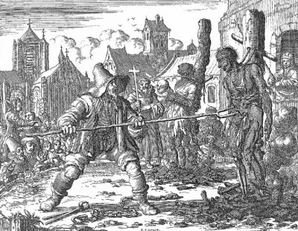
Spread of the Reformation
Section 4 Pg. 428

Slide 14
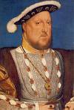

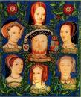
Other Protestant Groups
Anabaptists – believed in baptism only for people who accepted Christianity, no babies
England’s Reformation
King Henry VIII needed a son to be the next king but his wife was getting too old to have more children
wanted a divorce so he could remarry
divorce was against the cannon law of Catholicism
Henry takes over and starts a new religion in England called Anglican
divorce was now okay, he remarries several times and finally gets a son

Slide 15

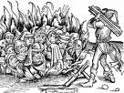
Catholic Reformation (Counter-Reformation)
church officials try to clean up their act and prevent people from leaving
no more indulgences or inappropriate behavior
non Christians (Jews, Muslims) continued to be persecuted
placed in ghettos – separate living spaces
some people accused of being witches

Slide 16


Slide 17
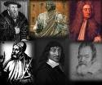
The Scientific Revolution
Section 5 Page 434

Slide 18


The Scientific Revolution
new way of thinking about the earth and universe
world can be understood using science/math and can be controlled by people
Nicolaus Copernicus – heliocentric theory, sun in the center of the universe
he and other scientists such as Galileo studied planets and their properties
ideas were not popular or accepted easily
they went against church teachings, scientists risked heresy with new ideas

Slide 19
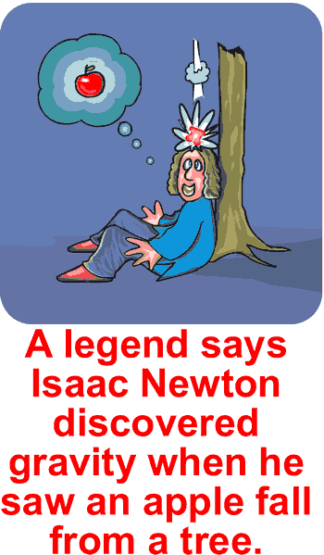

Scientific Method was revisited (pg. 436)
-experiments and observation needed to gain knowledge
-doubt everything unless you discover it for yourself
-new discoveries about the human body (anatomy), chemistry and laws of motion and gravity

