Slide 1
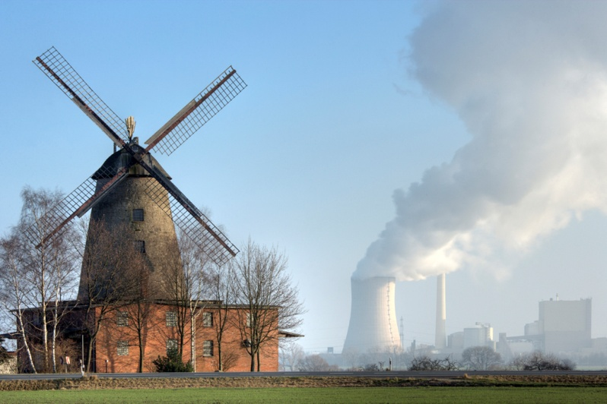

The Industrial Revolution
Chapter 19 Page 607

Slide 2
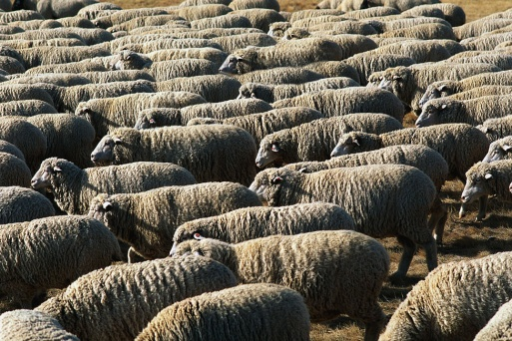
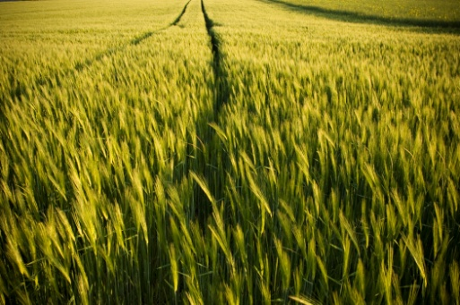
Agricultural Revolution – better methods of growing crops
-crop rotation
-better breeding and use of livestock
enclosures – surrounding farmland with fences or hedges
-new inventions
-population grows due to increase in amount of healthy food
*this combined with new technology and resources (coal/iron) led to the:

Slide 3

Industrial Revolution
increase in machinery and machine made products in the 1700s
began in Great Britain
many new inventions change lifestyles
cities grow
transportation easier

Slide 4


Section 2 Page 612
Britain Leads Industry

Slide 5
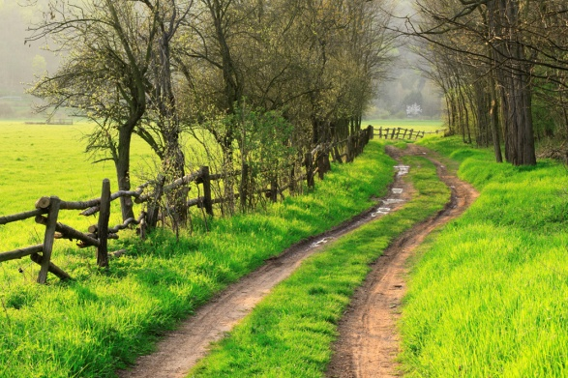
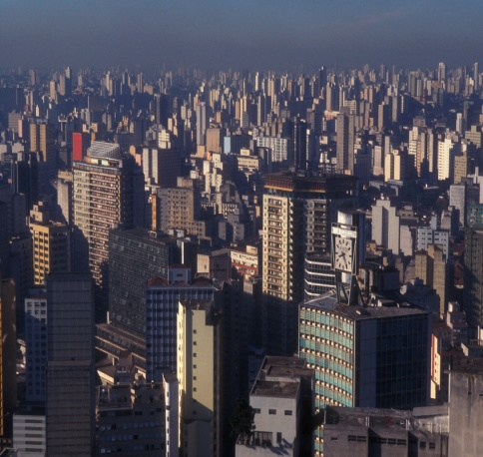
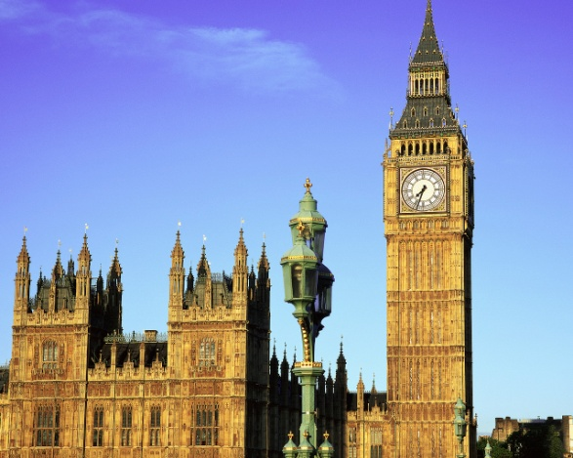
Lifestyle Changes
before 1800, rural life in Europe
after 1800, more urbanization – people moving to and the building
of cities
-London, England was the largest city
-filthy living conditions, much sickness and disease

Slide 6
Factors of Production
resources needed to produce goods/services, these are:
1. land -natural resources (water, coal, iron)
-rivers for transportation and water power (hydroelectric)
-ports – harbors on the water to import/export goods
2. labor – workers, population growth allows for these
3. capital -money and property needed to start businesses
Many people became entrepreneurs – people who start and manage a business
1st used in the textile industry (cloth making)
new inventions helped to speed the process
factories are built to maximize production with the new machines
people leave their homes for the 1st time to go to work

Slide 7
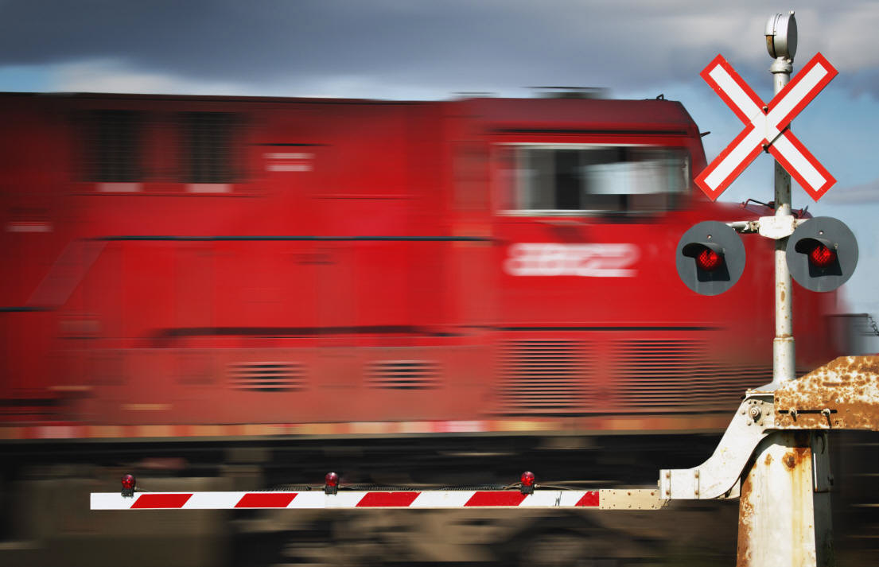
Transportation
needed to ship the manufactured goods to make money
built more roads and canals (waterways connecting rivers)
steam engine used to power the 1st trains too and railroads grow
products were now available everywhere, even in rural areas
prices fall due to an increase in supply

Slide 8
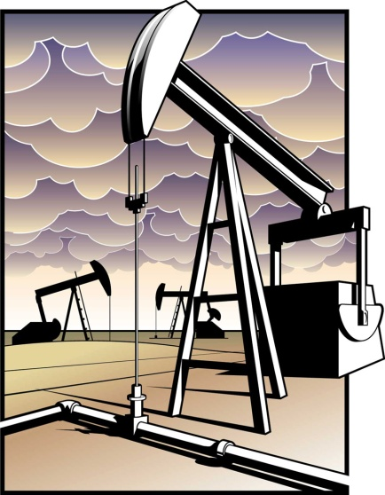
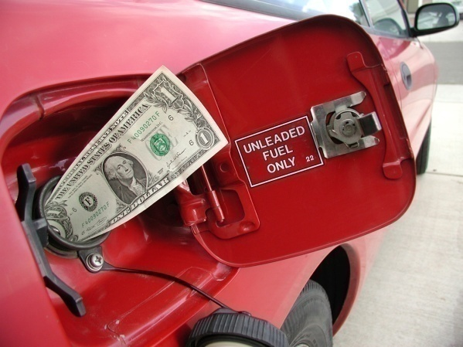
Supply and Demand
-if you have a large supply (lot of something), it will not be in demand
(needed) as much
- prices go down because they are harder to sell, everybody already
has it or doesn’t want it
-if you don’t have a lot of something, it will be in demand (needed)
-prices go up because they are easy to sell, everyone wants it!

Slide 9


Results of Industrialization
created jobs
increased wealth
more goods produced
better diets, housing, clothing
more education

Slide 10

Industrialization

Slide 11
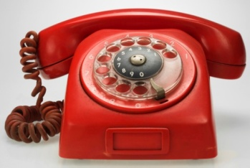

Spread of Industrialization
Section 3 Page 616

Slide 12
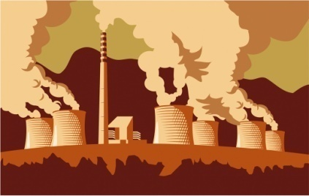
Urbanization
city building and people moving to the cities
this increases but had many negative effects
middle class created and lived comfortably
most were in the industrial working class
lived in tenements (apartment buildings), very crowded
filthy living conditions, sickness/disease

Slide 13
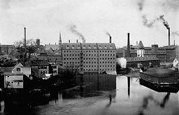
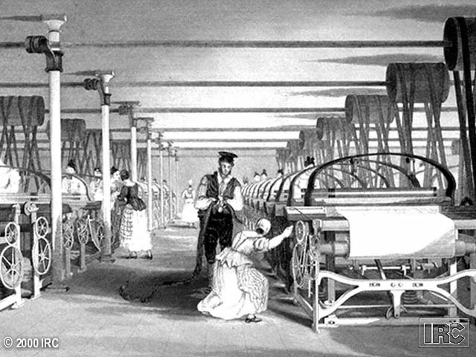
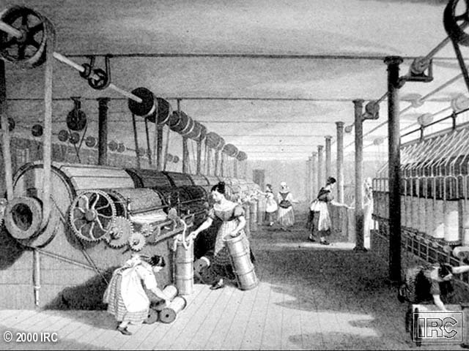
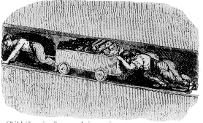
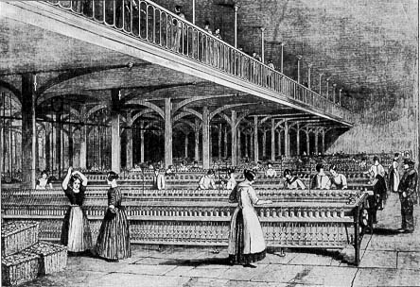
Factory Workers
-14 hours a day, 6 days a week
-dangerous working conditions
-poor pay, most workers live in poverty
-middle class – skilled workers, professionals,
businesspeople, rich farmers that benefited from urbanization
-start to become more wealthy than landowning middle class

Slide 14

United States
Britain blockades U.S. during War of 1812
forces them to produce their own goods using their own resources
first starts with textiles
used natural resources and new inventions (light bulb, telephone)
-railroads built by corporations – business owned by many stockholders who hope to share the profits of the business
-countries with resources and wealth got richer
-countries that were not industrialized fell behind and got poorer (no technology)

Slide 15


Industrialization brings Economic Change
Section 4 Page 622

Slide 16



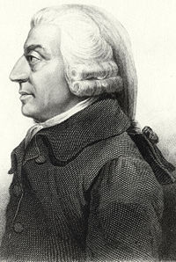

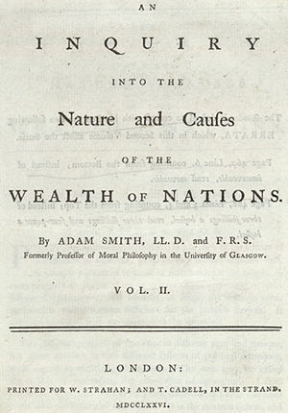

laissez-faire economics
- “hands off”, idea that the government should not
be involved in regulating businesses
-idea came from Adam Smith, The Wealth of Nations (1776)
-capitalism – economic system where money is invested in order to
make a profit
-also called free market system

Slide 17
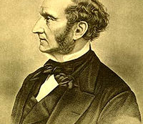
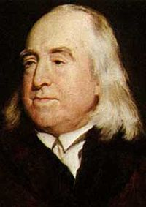
Utilitarianism
–idea that things should be done to create the most happiness for the most people
-John Stuart Mill and Jeremy Bentham
-called for equal distribution of wealth
John Stuart Mill
Jeremy Bentham

Slide 18
Socialism
– factors of production owned by the public and everyone can use them
-this would eliminate social classes and differences since
everyone is sharing the same resources and profits
-government should plan the economy
-opposite of capitalism
-supposed to result in equality
(Utopias – perfect societies)

Slide 19
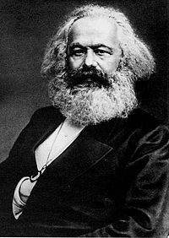
Karl Marx
The Communist Manifesto
-society divided into “haves” and “have nots”
-proletariat (workers) vs. bourgeoisie (employers)
-predicted that workers would overthrow employers, leads to:
communism – all means of production would be owned by the people, no private property, everything shared

Slide 20



Work Reforms
unions – workers joining together to gain better benefits, wages and working conditions
collective bargaining – negotiations between unions and employers
strike – refusing to work until demands are met

Slide 21
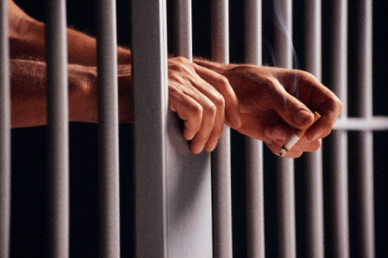
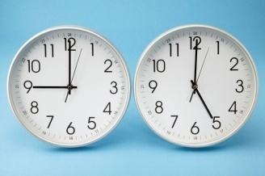
Other Reforms
maximum working hours set
laws for safer work environments
laws against child labor
women still made less money than men for same work
free public education system
prison reform – rehabilitate convicts to make them useful citizens again
Britain ends slavery in 1833

