Slide 1
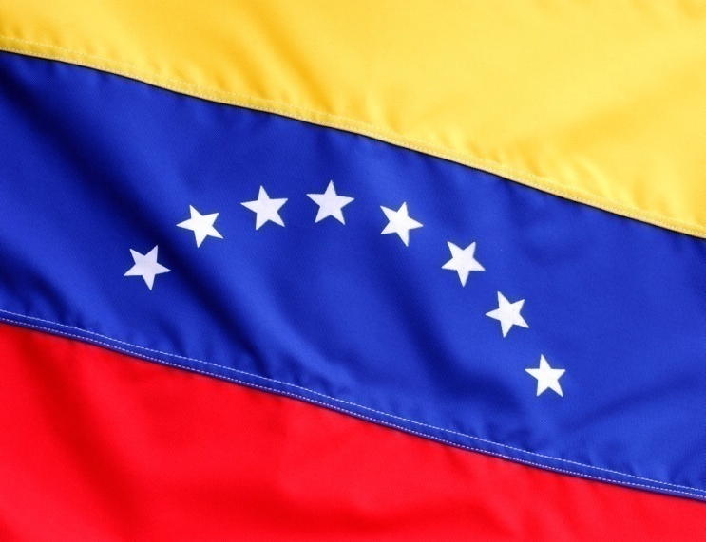

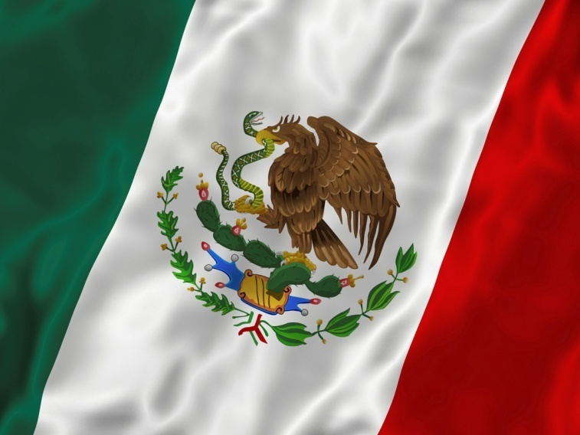

Chapter 20, Section 3
Page 645
Revolts in Latin America

Slide 2
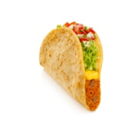



Spanish lessons
A - always sounds like AH
E – always sounds like EH
I – always sounds like EE
O – always sounds like OH
U – always sounds like OOH (never YOOH)
example: Taco
example: Tres
example: Si
example: Hola
example: UNO

Slide 3
Practice Words
Spanish Word/Phrase
Pronunciation
Agua
Gracias
Amigo
Donde esta el bano?
No credito
AH–gooah (water)
GRAH–see-ahs
(thank you)
ah-MEE-go (friend)
DOHN-day eh-STAH EHL BAHN –yo (Where is the bathroom?)
NO CREHD-ee-toh (no credit)

Slide 4
Social Classes
1. Peninsulares - highest social class, people born in Spain or from Europe
dominated life, had best jobs, money and power
made up <1% of the population
held 90% of the land
2. Creoles – family history from Europe but born in the New World
owned land, had decent jobs but limited power
many were educated back in Europe where they learned Enlightenment ideas like natural rights

Slide 5
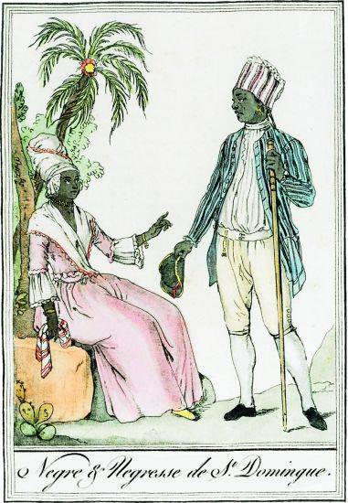
Social Classes
3. Mestizos – mixed Native American and European people
3. Mulattoes – mixed African and European people
very low status and wealth, no power
4. Native Americans and Africans –used as slaves, worked for upper classes

Slide 6
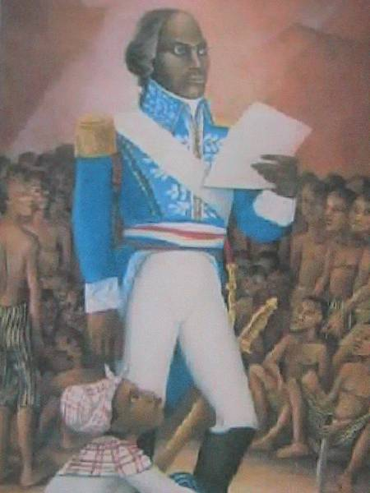
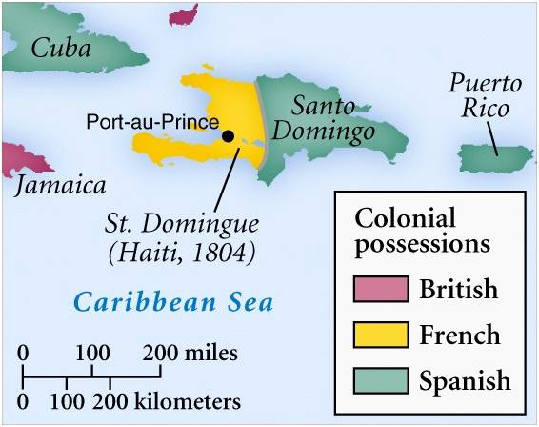
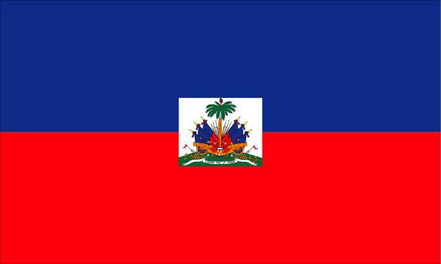
Haiti
-Island in the Caribbean Sea, colony of France
-slave labor used on sugar plantations
-slave revolt led by Toussaint L’Ouverture overthrows the French
-Haiti becomes its own country

Slide 7
Mexico
creole priest Miguel Hidalgo (ee-DAHL-go)inspires people to fight for freedom
unsuccessful but a few years later another priest, Jose Maria Morelos continues the fight
wanted changes such as improved living conditions, no slavery and voting rights
independence finally achieved in 1821, with the help of another creole, Augustin de Iturbide (ee-tur-BEE-day)
the countries in Central America also split and became independent (1838)

Slide 8
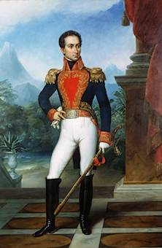
South America
creoles saw other countries (U.S., Mexico) becoming free and thought they could do it too
Simon (see-MOHN) Bolivar – creole from Venezuela who freed his country from the Spanish
also helped free neighboring countries
known as “el Libertador” (the Liberator)

Slide 9
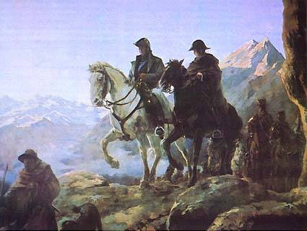
Jose de San Martin (mar-TEEN)
-from Argentina, joins with Bolivar and helps to free countries in the Southern part of S. America

Slide 10
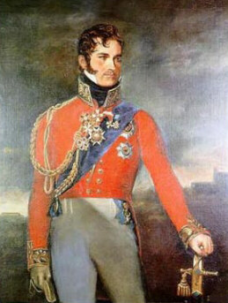
Brazil
-earned its freedom without conflict
-the king, Dom Pedro, gave up some power and accepted reforms and government changes so no fighting was necessary

Slide 11
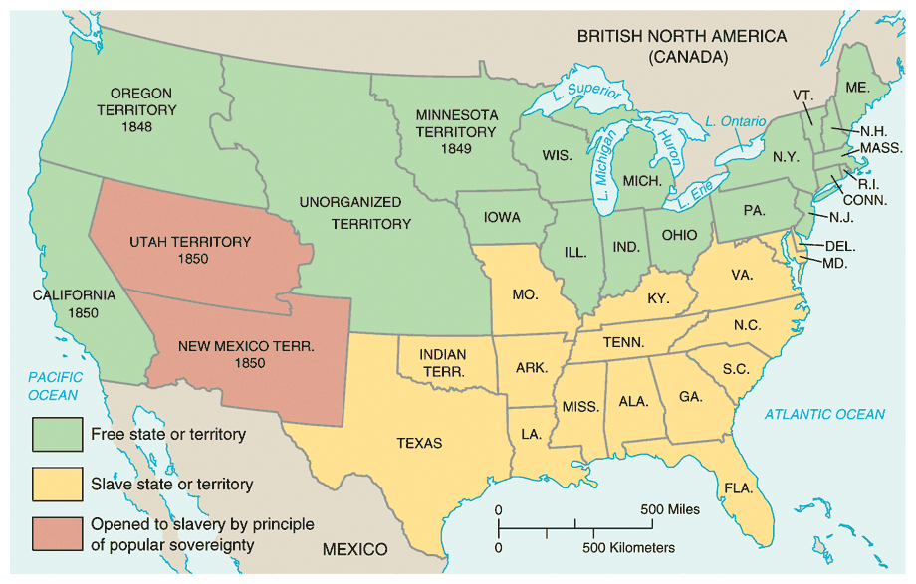
The U.S. expands p. 739
23.4 Outline

Slide 12
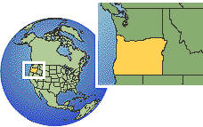
The Louisiana Purchase
-land bought from France by president Thomas Jefferson that
doubles the size of the U.S. (see map p. 742)
-1819, U.S. gains Florida from Spain
-1846, U.S. gains Oregon territory from Britain

Slide 13
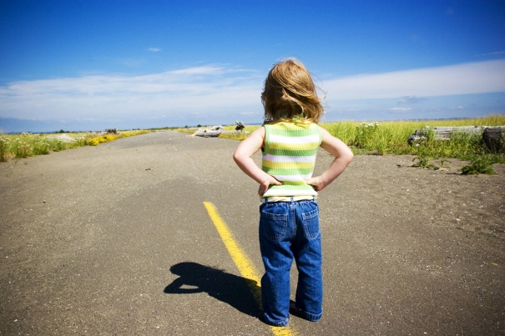
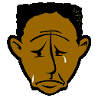
Manifest Destiny
idea that the U.S. should expand its borders all the way to the Pacific Ocean.
used this idea to justify the taking of land from countries and Native Americans
Indian Removal Act of 1830, allows for the:
Trail of Tears
Indians forced west to Oklahoma, kicked off land
many died from sickness and fatigue on the voyage

Slide 14
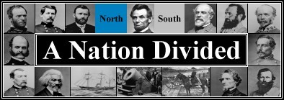
THE AMERICAN CIVIL WAR
1861-1865

Slide 15
The Civil War
North vs. South
North – industrial economy, used free workers
South – agricultural economy, used slaves
as U.S. was getting new land, was it going to be slave territory or free?
South sees their rights as states being violated and threaten to secede (separate)
North says that the country must stick together
1861, Civil War begins shortly after Abraham Lincoln is elected president
Southern states form their own country, Confederate States of America

Slide 16
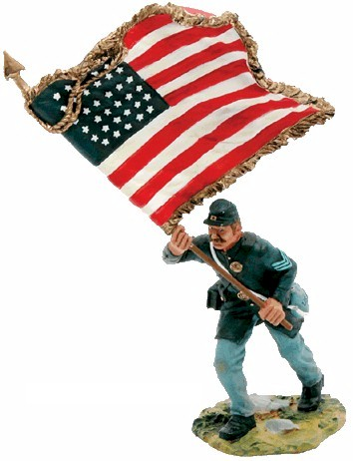
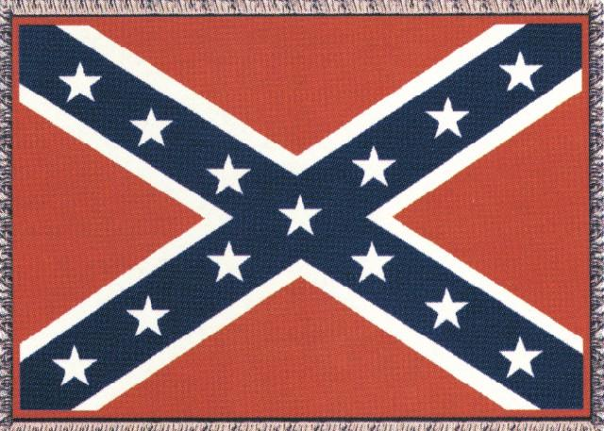
The Civil War: Union vs Confederacy

Slide 17
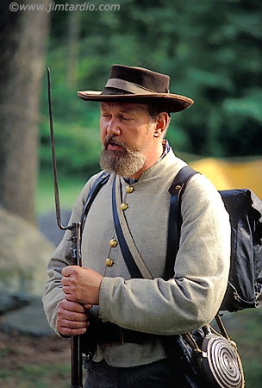
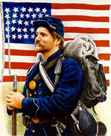
Confederate Union

Slide 18
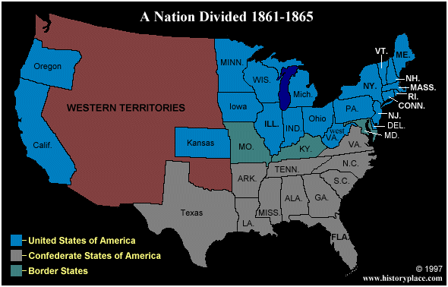
The first States secede

Slide 19
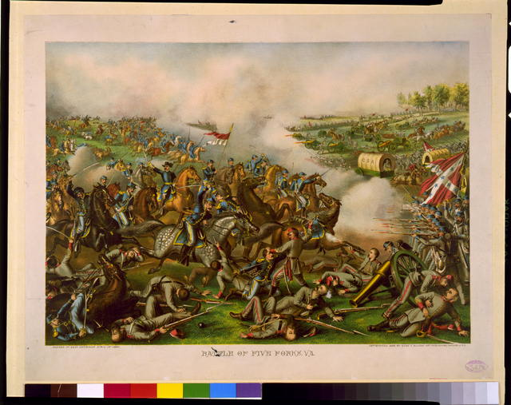
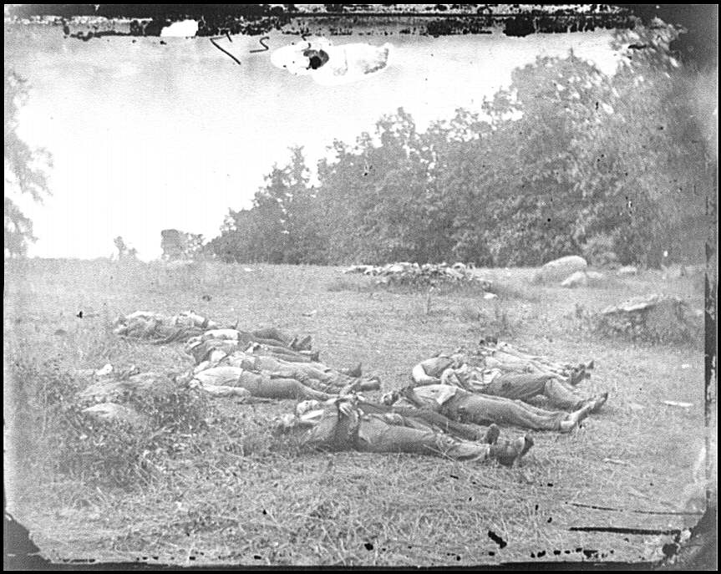
North (Union) goes to war to bring the southern states back
After four bloody years of civil war,
the South was defeated.
Over 618,000 military deaths during Civil War.

Slide 20
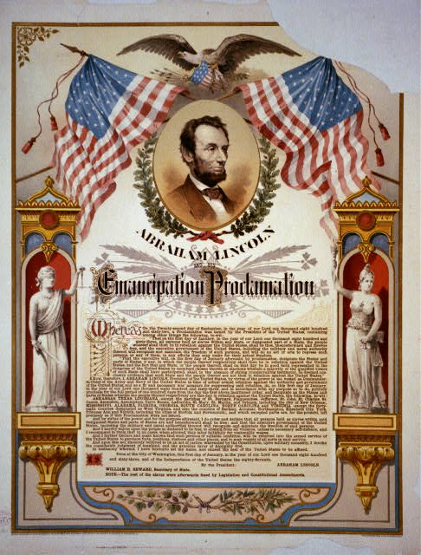
Emancipation Proclamation
Lincoln’s document stating that slavery was illegal in the U.S.
slavery officially ends with the 13th amendment and blacks earn the right to vote with the 15th amendment
segregation (separation of races) and racism still existed however

Slide 21
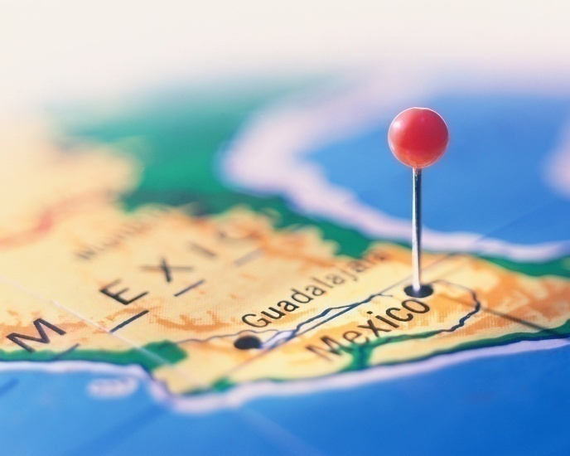
Imperialism in Latin America
25.4 Outline p. 801

Slide 22

Imperialism
taking over other countries as colonies
most people’s lives in Latin America did not improve after independence
only the creoles saw improvement
others had no power, voting rights and in most cases no land
most areas ruled by caudillos (dictators)

Slide 23
Mexican-American War
Antonio Lopez de Santa Anna – leader in fight for freedom against Spain, becomes president (caudillo) of Mexico
Americans in Mexican territory of Texas not happy because of slavery, no freedom of religion or progress
want more freedoms but Santa Anna says no
Texans revolt and eventually gain freedom (1836)
U.S. adds Texas in 1845
Mexican-American War takes place, Mexico defeated
sign treaty of Guadalupe Hidalgo – gives U.S. land from Texas to California

Slide 24
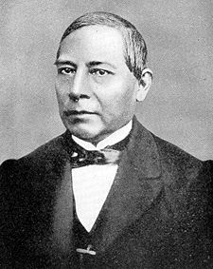
Benito Juarez
-poor Indian who started reform movement (La Reforma)
-wanted land reform, education, separate church/state
-becomes Mexican president in 1858

Slide 25








-France invades Mexico and takes over for four years
-Mexico fights off French and eventually Juarez was president again
-new reforms: foreign trade, roads and railroads, education

Slide 26
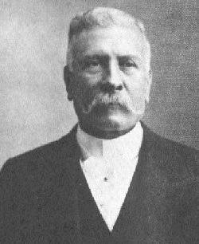
Porfirio Diaz
-takes over in 1870s
-caudillo who used terrorism and favoritism to get his power
-elections were meaningless
-some progress but most people still poor
-most worked for large landowners under a system of:

Slide 27
Peonage
paid with vouchers to be used at the owner’s supply store
prices on products were high, income was low
workers went into debt
landowners became richer

Slide 28

Latin American Trade
begin to trade with U.S. and Britain
economy based on exports
helped by new transportation and refrigeration process
did not have manufacturing, had to import these goods
did not use their money to pay for roads, schools, hospitals
were not very self-sufficient
borrowed money from industrialized countries
went into debt, still controlled economically

Slide 29
Monroe Doctrine
-document by president James Monroe stating that the Americas cannot be colonized by Europe anymore.

Slide 30
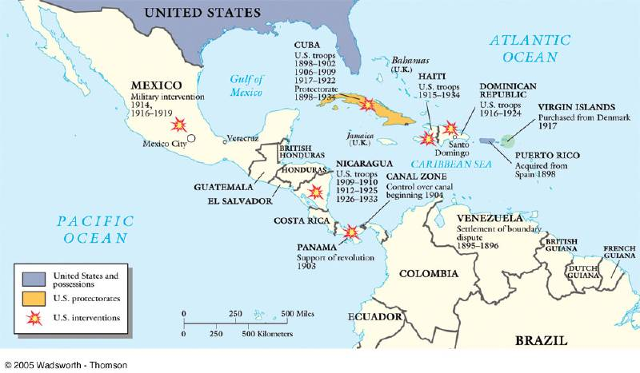
Cuba and the Spanish American War
colony of Spain
1868, declares independence and fights 10 year war
U.S. helps Cuba win for two reasons:
1. held businesses there
2. Spain put people in concentration camps
-U.S. stays in Cuba and sets up government
-Cubans not happy with U.S. (even today)

Slide 31
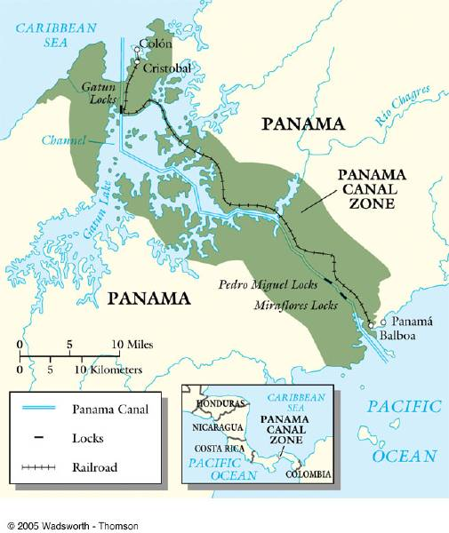
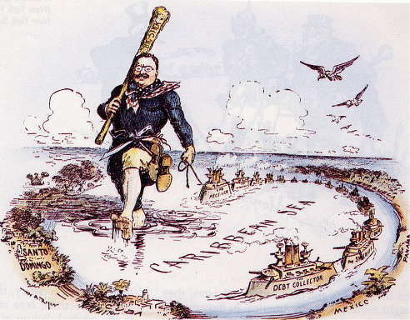
Panama
-U.S. helps Panama win independence from Colombia
-rewarded with 10 mile wide strip of land to make the:
Panama Canal
U.S. oversees all of the Americas after the:
Roosevelt Corollary – president Theodore Roosevelt says the U.S. should have police power in the Western world

Slide 32
Struggle in Latin America
27.1 Outline p. 852

Slide 33
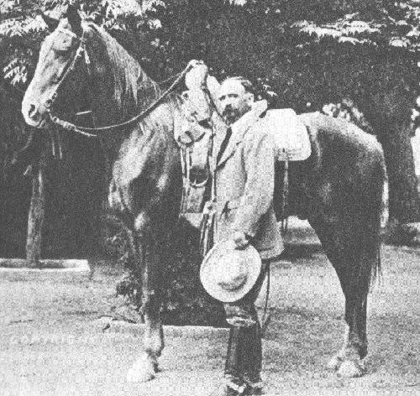
people fed up with Porfirio Diaz and his tactics
Francisco Madero
-arrested for trying to run against Diaz in presidential election
-sent to U.S. where he called for a revolution to overthrow Diaz
this would be the Mexican Revolution (see p. 853)

Slide 34
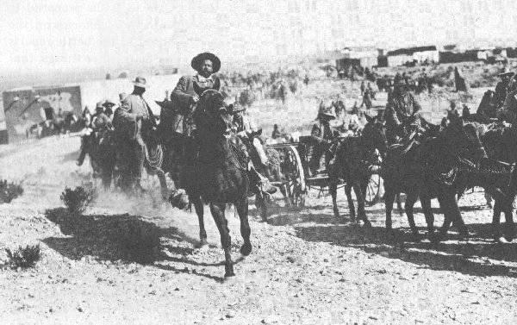
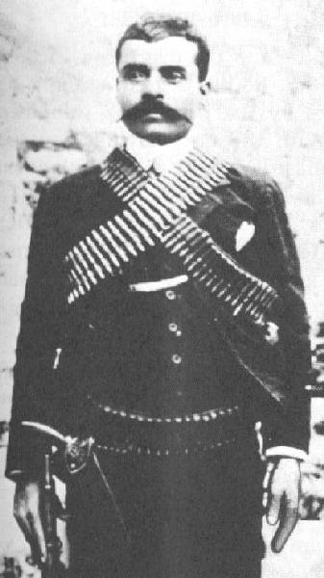
Mexican Revolution
-led by Francisco “Pancho” Villa in the north and Emiliano Zapata in the south.
-successful in defeating Diaz and forcing him out of office
-also made sure that peasants and small farmers received land
“Pancho” Villa
Emiliano Zapata

Slide 35

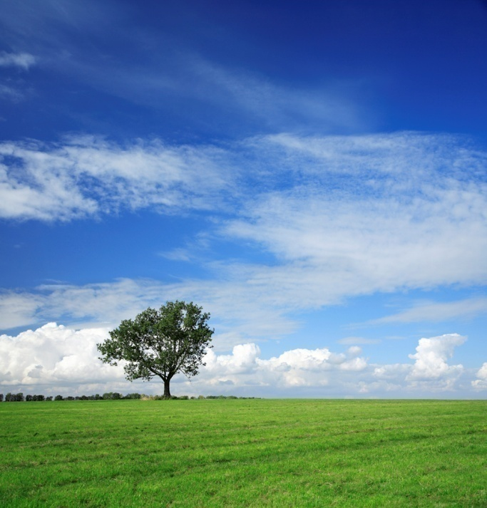
Civil War
-occurs in Mexico over power, 1 million die including Zapata
-1917 Mexico adopts a new constitution full of reforms

