Slide 1
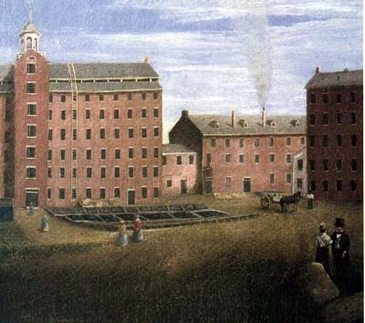
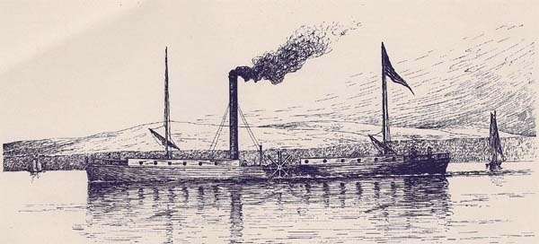

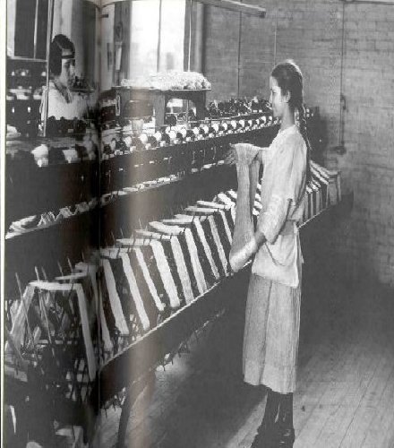
Chapter 21 Page 659
Life in the Industrial Age

Slide 2
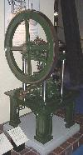
-Other countries gain industry (U.S., Germany, France) due to a lot of natural resources
-competition occurs between countries with industry
-unindustrialized countries fall behind
Steam Engine

Slide 3
New Technology and Inventions
steel (from iron)
dynamite
electricity and light bulb (Thomas Edison)
interchangeable parts – pieces that can be used in place of each other
assembly line – workers add parts to a product while it moves along a conveyor belt. Each worker has one piece that they are responsible for.
these make production faster and cheaper
automobiles (Henry Ford)
airplanes (Wright Brothers)
telegraph (Samuel Morse) – sends messages over wires electronically, morse code
radio (Guglielmo Marconi) and telephone (Alexander Graham Bell)
PRODUCTION
TRANSPORTATION

Slide 4


Slide 5

New Business practices
corporations – businesses owned by several people
investors – people who provide money to businesses in hopes of making a profit
stock – tiny pieces of a business that investors can buy

Slide 6
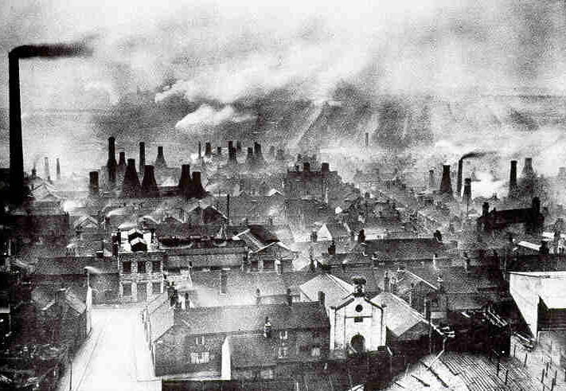
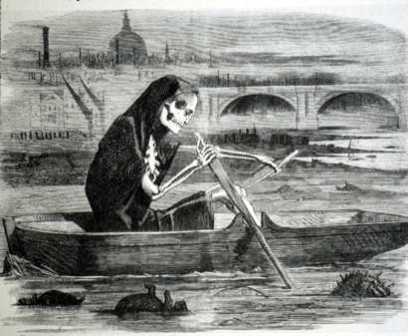
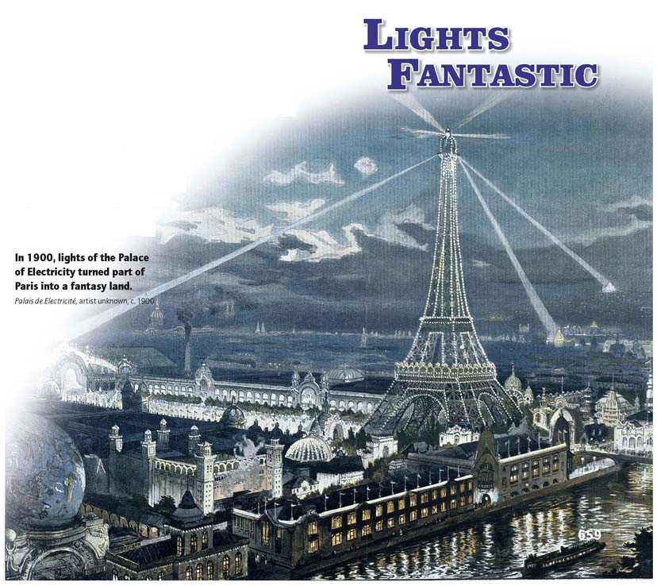
Section 2 Page 667
The Rise of Cities

Slide 7
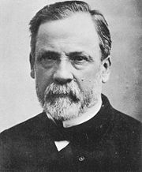


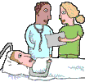
Cleaning up
Louis Pasteur – discovered that tiny organisms (bacteria) caused diseases
made some vaccines
pasteurization – way to remove bacteria from milk
people realized that they needed to be clean to get rid of bacteria
hospitals became sanitized and disinfected to help also

Slide 8

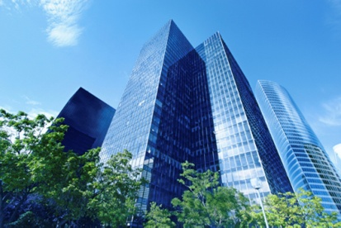
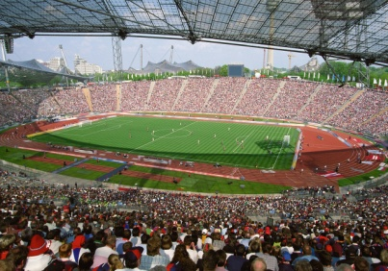
city streets paved and lighted
police force for public protection/safety
clean water supply
sewage and sanitation systems
skyscrapers built to save space
entertainment/culture (sporting events, concerts, plays, libraries, museums)
unions organized for worker’s rights/wages
laws against child labor passed
limiting of working hours
better safety standards
Other Changes
Work Reforms

Slide 9


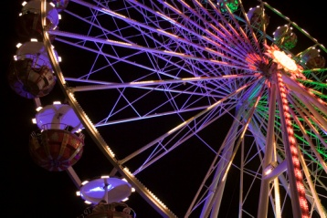
Standard of living
-the amount of quality and comfort that a person/family has in
life
-this increased for most people at this time
-more food (healthier too), cheaper goods (esp. clothes),
cleaner environment, better transportation, etc.

Slide 10

Cultural Change
Section 3 Page 674

Slide 11
Cultural Change
Temperance movement – limiting or getting rid of alcohol
leads to prohibition
Suffrage movement – trying to earn the right to vote for women
public education becomes available to more and more families (women and lower social classes too)
More colleges and universities built also

Slide 12
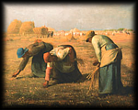
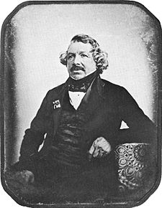
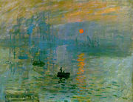
Art in the Industrial Age
Section 4 Page 681

Slide 13
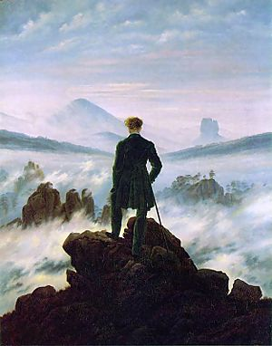

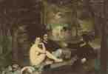
Romanticism – art that emphasizes imagination, freedom and emotion
used simple language, intense feelings and positive view of nature
Realism – art that tried to show the world as it really was
Louis Daguerre – makes the first photographs (daguerreotypes)
Impressionism – tried to show emotion from one point in time

