Slide 1
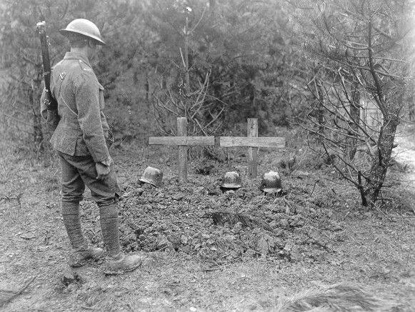
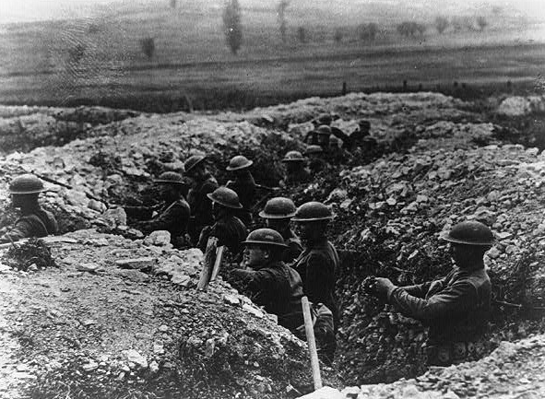
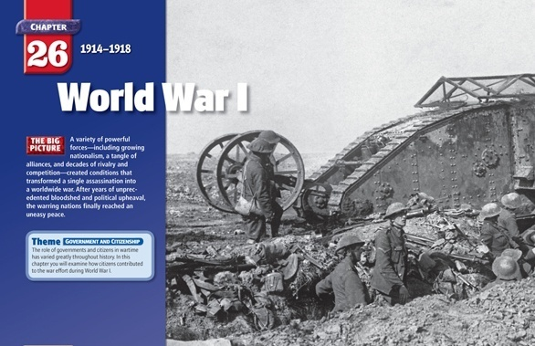

Chapter 26 Outline
World War I (p. 815)

Slide 2



Europe was at peace from 1870 to early 1900’s
peace organizations and progress made war unnecessary

Slide 3
Forces leading to war:
Nationalism
Imperialism
pride and caring for one’s nation
leads to competition between countries
materials and markets
Britain / Germany especially fight for industry
-taking over other countries as colonies
-more competition to see who gets what land

Slide 4
Forces leading to war:
Militarism
Alliances
increasing military power and preparing for war
standing armies – large number of soldiers
able to mobilize quickly
-groups of countries working together to defend themselves and keep the peace (supposedly)
-Triple Alliance – Germany, Austria-Hungary and Italy
-Triple Entente – Great Britain, France and Russia
*any fight or conflict involving any of these countries could lead to massive conflict. They all agreed to help each other*

Slide 5
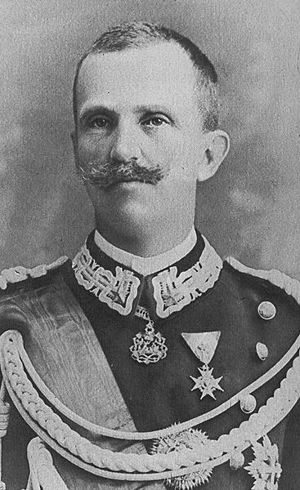
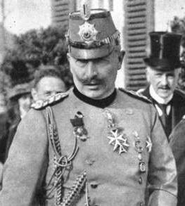
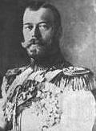
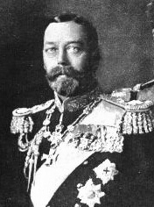
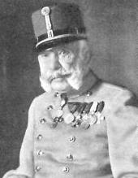
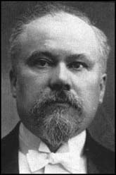
The Major Players: 1914-17
Triple Entente:
Triple Alliance:
Nicholas II
[Russia]
George V [Britain]
Wilhelm II [Germany]
Victor Emmanuel II [Italy]
Franz Josef [Austria-Hungary]
Pres. Poincare [France]

Slide 6
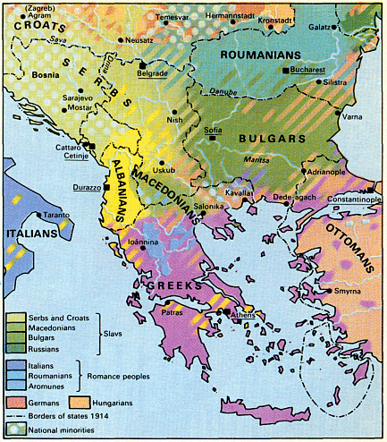
The Balkan Peninsula
full of many ethnic groups with not much land. Each group wants their own space.
Austria takes over some of this area that Serbia had been fighting for (Serbia has support from Russia)
Serbia begins to fight to regain land from Austria

Slide 7
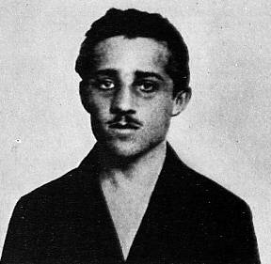
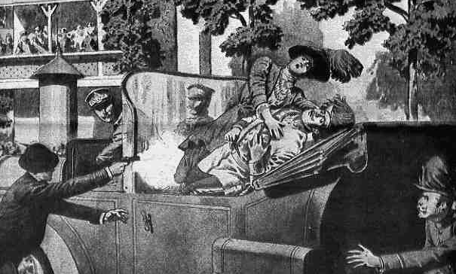
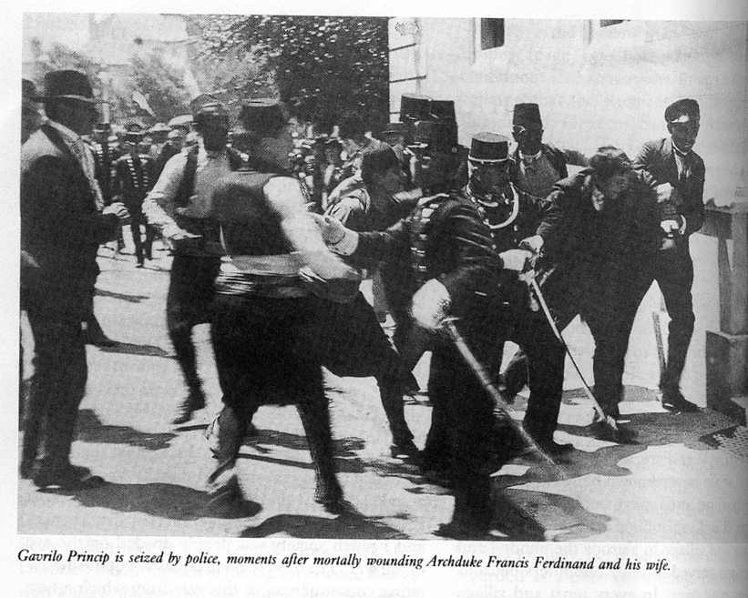
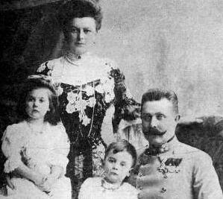
World War I Begins
Gavrilo Princip
Franz Ferdinand and his family
War begins when: heir to throne of Austria-Hungary, Archduke Franz Ferdinand and wife shot in car by Gavrilo Princip.

Slide 8
The Spark that leads to war
Princip was member of the Black Hand – terrorist group wanting Austria out of the Balkans.
Austria retaliates with list of demands (ultimatum) and when they were not met they declare war
Emperor Franz Joseph

Slide 9
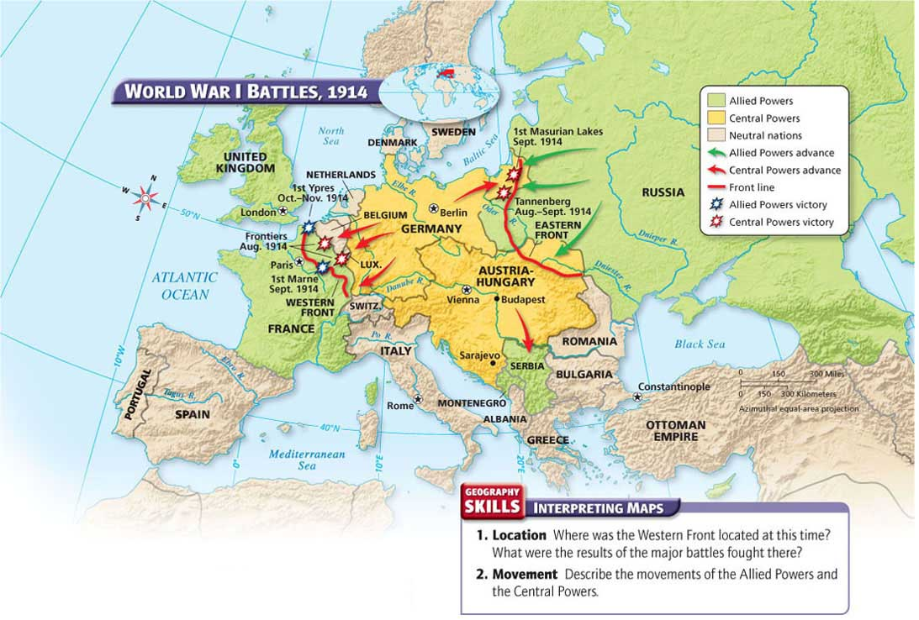
The War Begins
Russian troops sent to Austrian border and German border as precaution
Germany declares war on Russia and France
Used the Schlieffen Plan – attack France in the west first and then defeat Russia in the east

Slide 10
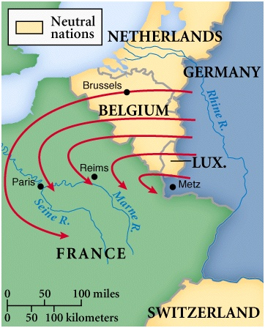
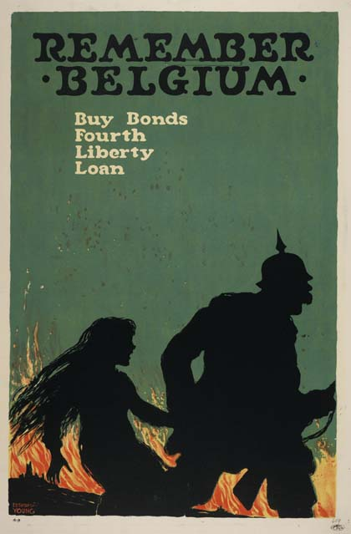
More countries get involved
-Germany needed to move fast, but France had border blocked well
-decided to go through Belgium (neutral country)
-Belgium says no, Germany invades Belgium anyway
-Britain upset by this and helps Belgium by declaring war on Germany

Slide 11
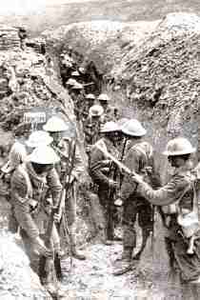
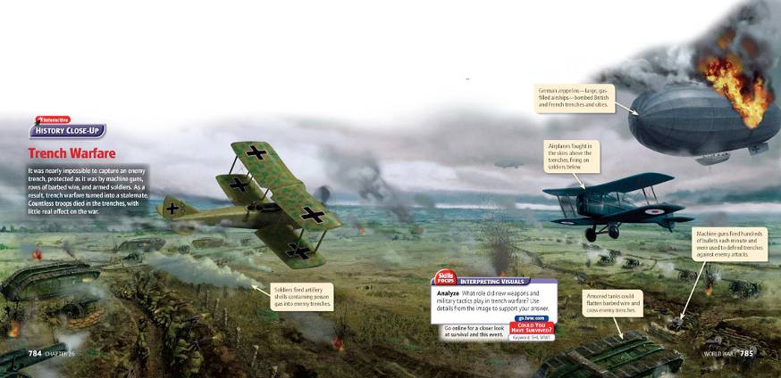
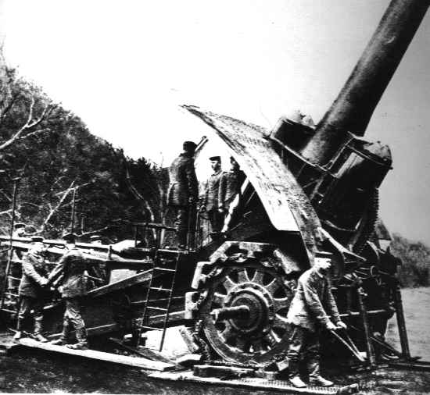
Section 2 Page 822
The Early Stages of War

Slide 12
The Sides Form
Central Powers
Allied Powers (Allies)
Germany and Austria-Hungary
plus Bulgaria and Ottoman Empire
Great Britain, France and Russia
plus Japan and Italy

Slide 13
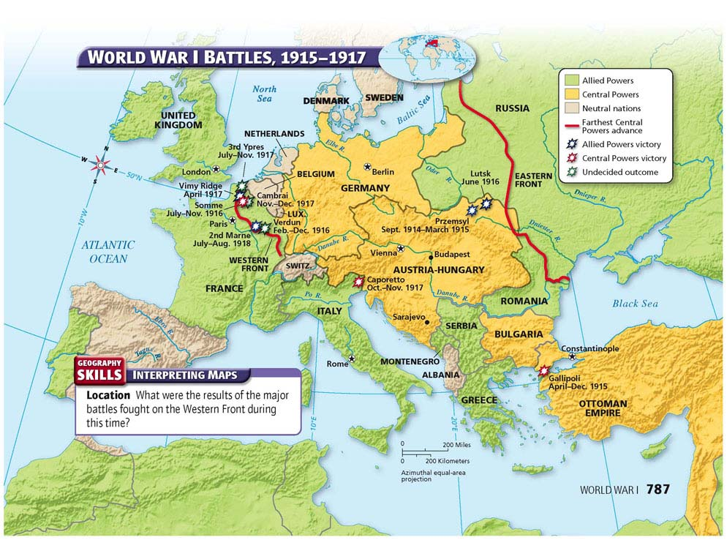
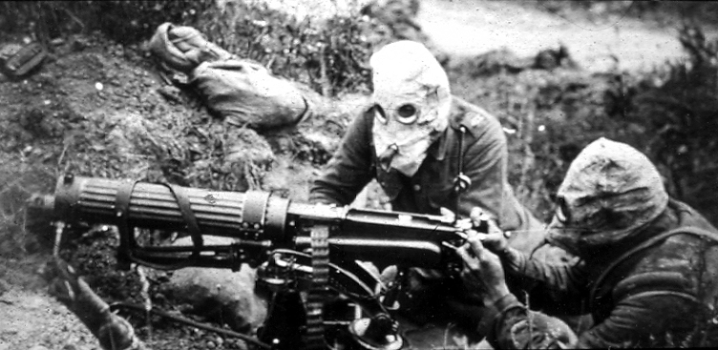
Germany Fights on Two Fronts
WESTERN FRONT
vs. France, started off well, almost reached Paris but defeated at battle of the Marne and had to retreat
eventually reaches a stalemate
trench warfare – digging large ditches on each side of a battle
machine guns, poison gas, tanks, airplanes and submarines all used

Slide 14
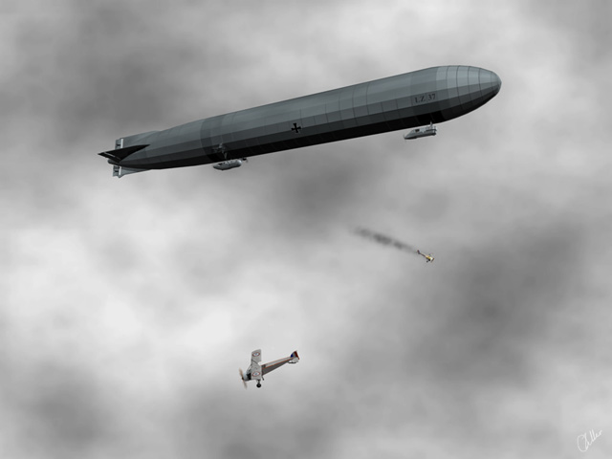
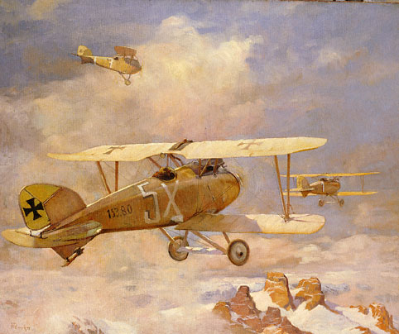
Germany Fights on Two Fronts
EASTERN FRONT
vs. Russia, more movement of soldiers than west
Russia not industrialized, short on supplies and food
had massive population though
many deaths but soldiers replaced easily, used to tie up Germany and weaken them in the west

Slide 15
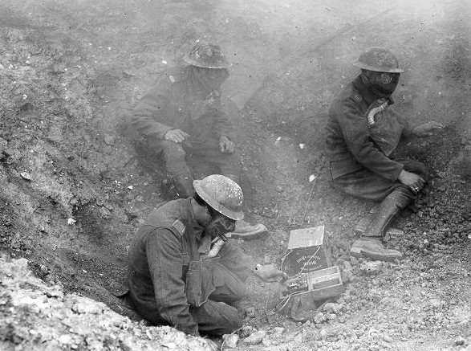
War spreads outside of Europe
-other countries involved making it a world war.
-Japan joins the Allies
-Bulgaria and Ottoman Empire joins Central Powers
-war was at a stalemate

Slide 16
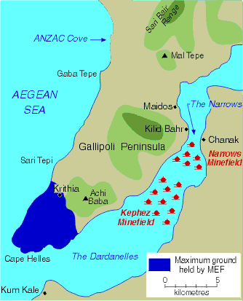
Gallipoli Campaign
Allies wanted to capture the Dardanelles - straits near the Ottoman Empire
this would give them a supply line to Russia
also results in stalemate though
-Germany’s colonies are attacked and conquered by Allied forces
- British and French use colonized people as soldiers and workers

Slide 17
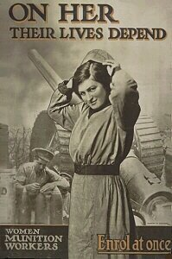
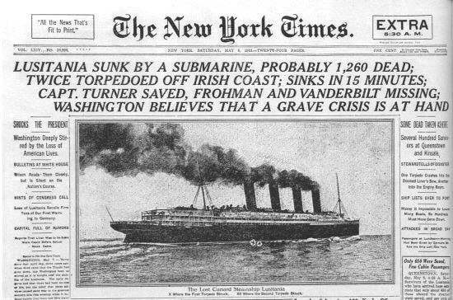
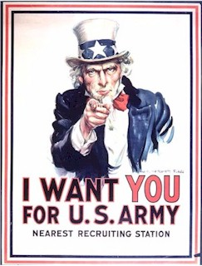
Section 3
Page 829

Slide 18
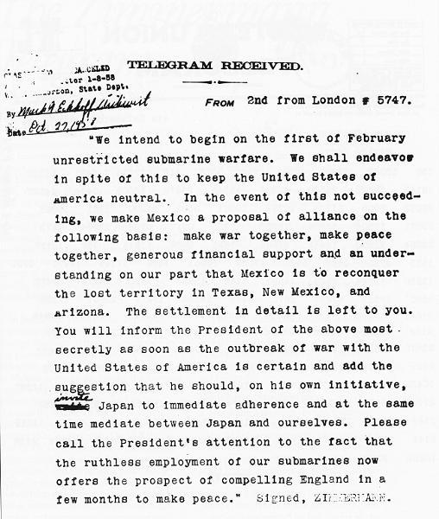

U.S. enters the war in 1917 because:
unrestricted submarine warfare
Zimmerman Telegram
sinking all ships found in enemy territory
includes civilian ships
Lusitania - British passenger ship with Americans aboard, sunk by German U-boats
secret letter from Germany to Mexico telling them that they would help Mexico regain lost land if they joined the Central Powers.
The U.S. also had strong economic ties with the Allies

Slide 19

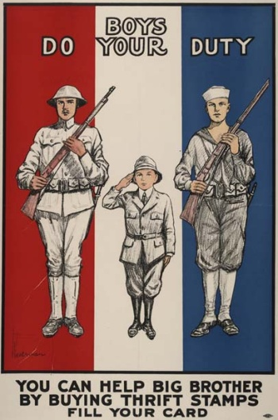
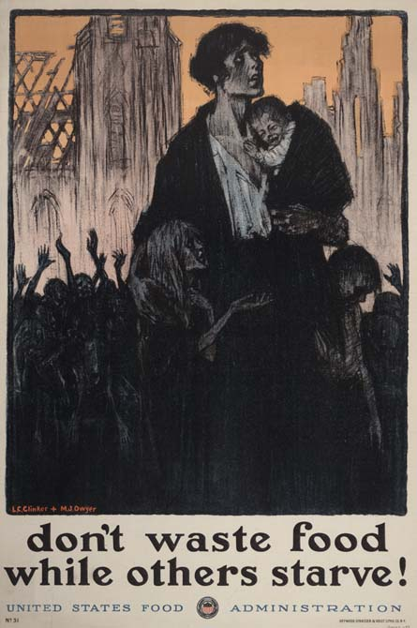
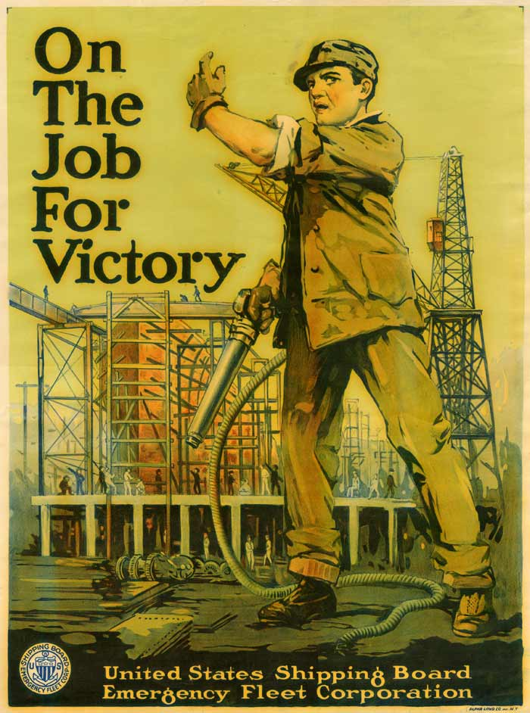
Total War
countries used all possible resources to win the war.
gov. controlled economy and prices
everybody worked (very low unemployment rate)
rationing - limiting the amount of certain items that were also needed in the war effort
governments used censorship to control war protests and
propaganda - one-sided information to persuade people or keep their morale up.

Slide 20
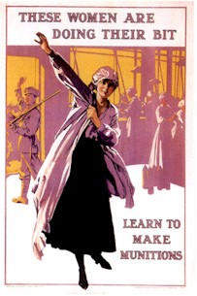
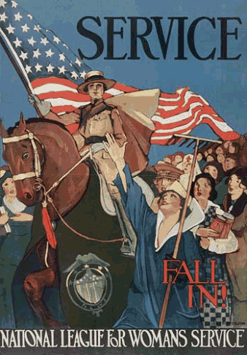
Women enter the workforce
-take many jobs that used to be for men only

Slide 21
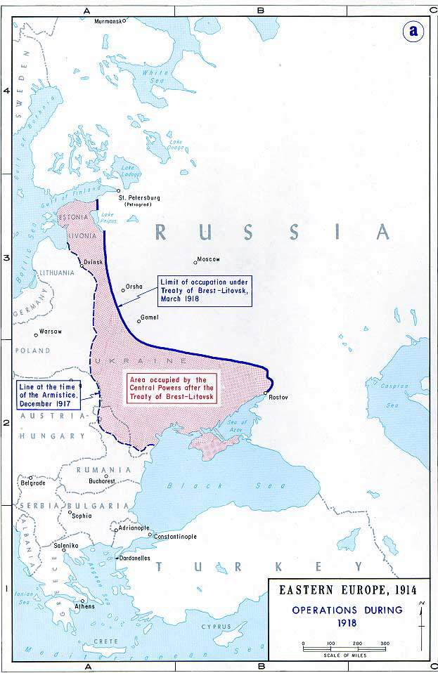
Breaking the Stalemate
Russia withdraws from the war due to shortages of supplies
signs the Treaty of Brest-Litovsk with Germany
had to give up some land
now Germany could send all troops to Western Front
successful in gaining territory almost all the way to Paris
used up a lot of supplies to get there though, men tired
Allies, including fresh American soldiers, defeat them and push them back to Germany
War ends with an armistice (treaty) on Nov. 11, 1918

Slide 22
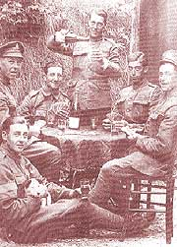
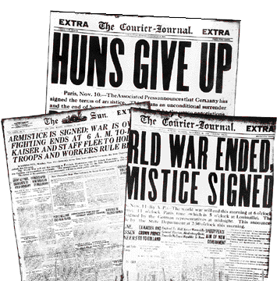
Section 4
Page 834

Slide 23
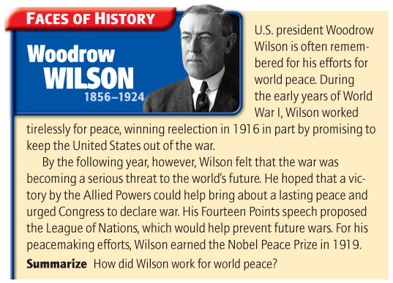
Treaty of Versailles
agreement between Germany and Allied powers
Germany given total blame for the war and must pay $33 billion in reparations
Germany loses all colonies
German military limited (no submarines or air force)
League of Nations - group of countries that would keep peace throughout the world.
Led by: U.S., Britain, France, Italy and Japan
Germany and Russia left out
Austria-Hungary split into many different countries, Russia loses land (map p. 837)
peace doesn’t last, many countries unhappy with agreement
eventually leads to World War II

Slide 24
War Facts
-8.5 million soldiers died -21 million wounded
-cost of war: $338 billion

