Slide 1
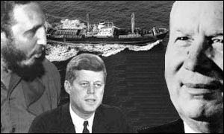
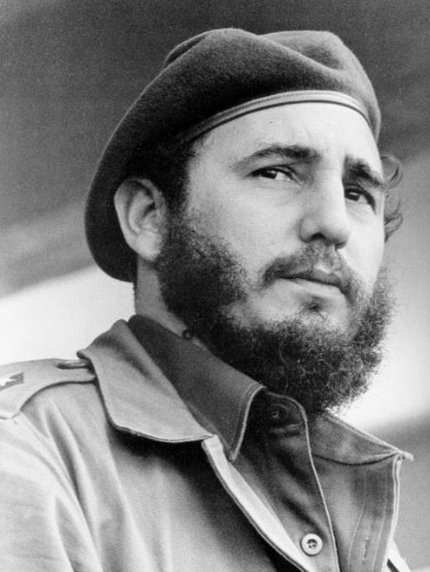
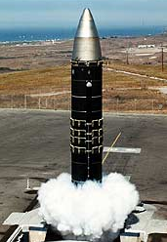
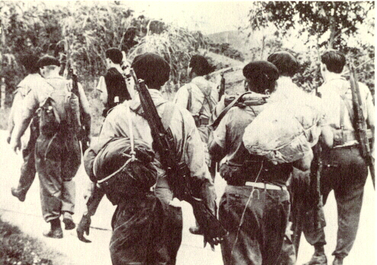

Chapter 30 page 964
The Cold War

Slide 2
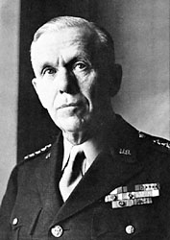
Marshall Plan [1948]
“European Recovery
Program.”
Secretary of State,
George Marshall
The U. S. should provide
aid to all European nations
that need it.
$12.5 billion of US aid to Western Europe
extended to Eastern Europe & USSR, [but this was rejected].

Slide 3
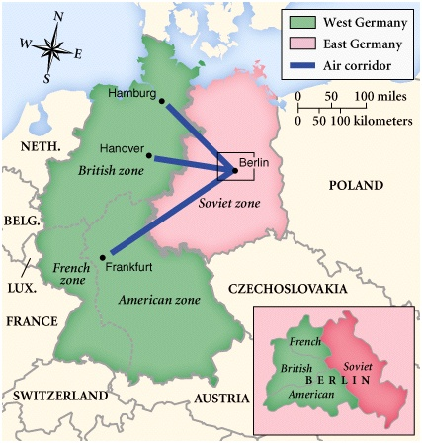
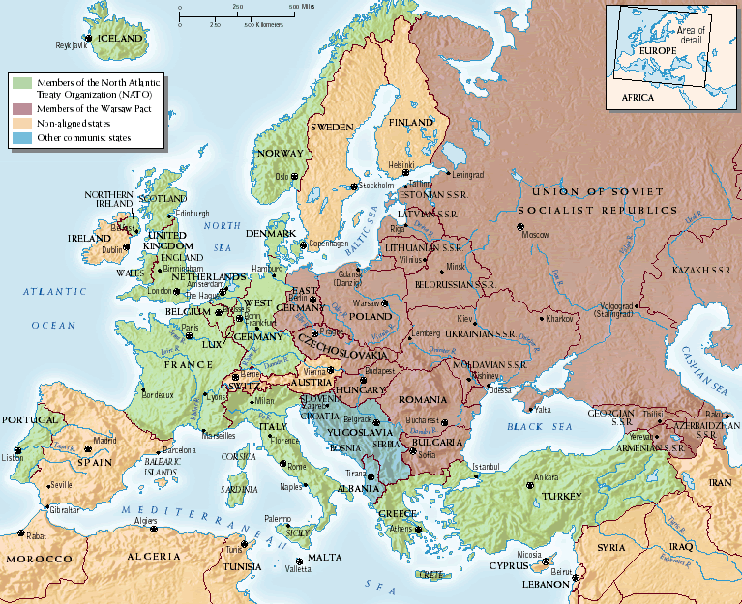
Two Superpowers Remain
Soviet Union
Leads the Warsaw Pact in Eastern Europe
Countries stronger than everybody else
United States
Leads NATO in Western Europe
Separated by the Iron Curtain

Slide 4
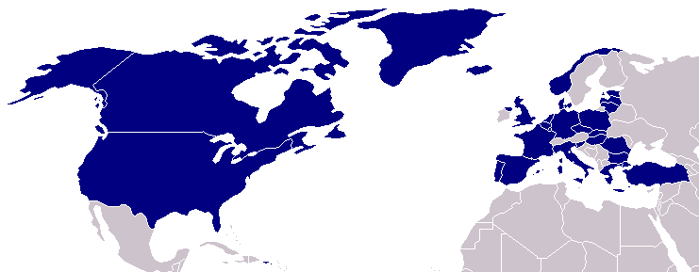
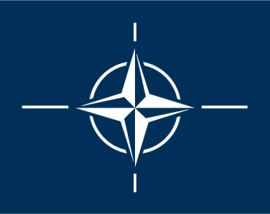
North Atlantic Treaty Organization (1949)
United States
Belgium
Britain
Canada
Denmark
France
Iceland
Italy
Luxemburg
Netherlands
Norway
Portugal
1952: Greece &
Turkey
1955: West Germany
1983: Spain

Slide 5

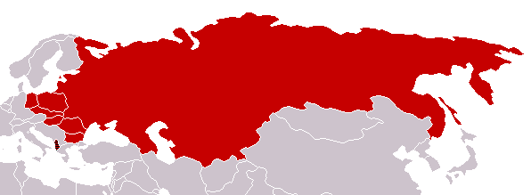
Warsaw Pact (1955)
U. S. S. R.
Albania
Bulgaria
Czechoslovakia
East Germany
Hungary
Poland
Rumania

Slide 6
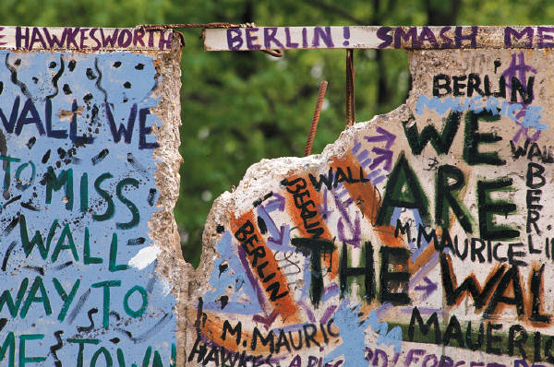
The Berlin Wall
-Many people were leaving East Germany to go West
-East Germans build it to separate East Germany (communist) from West Germany (democratic)
-kept people from leaving the East

Slide 7
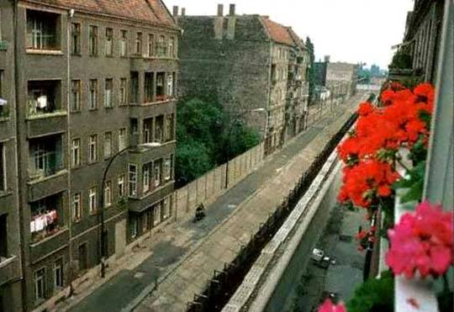
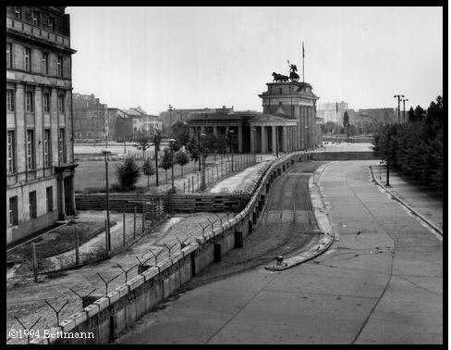
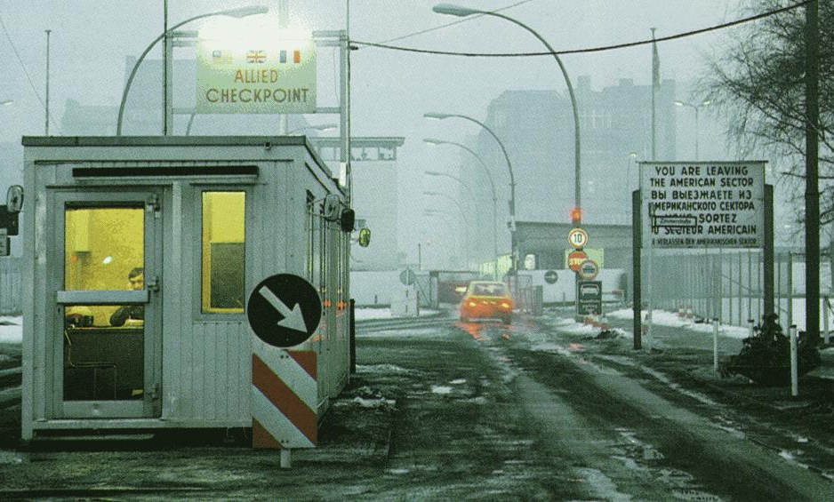
The Berlin Wall Goes Up (1961)
Checkpoint
Charlie

Slide 8
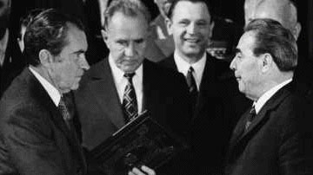
Nuclear Weapons
Both sides began an arms race to get the most powerful weapons (1950s)
People on both sides lived in fear of total destruction
Eventually began Strategic Arms Limitation Talks (SALT) to limit weapons (1970s)

Slide 9
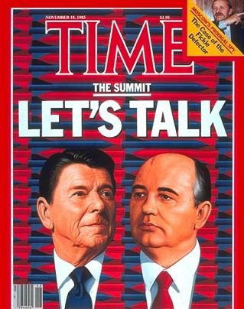
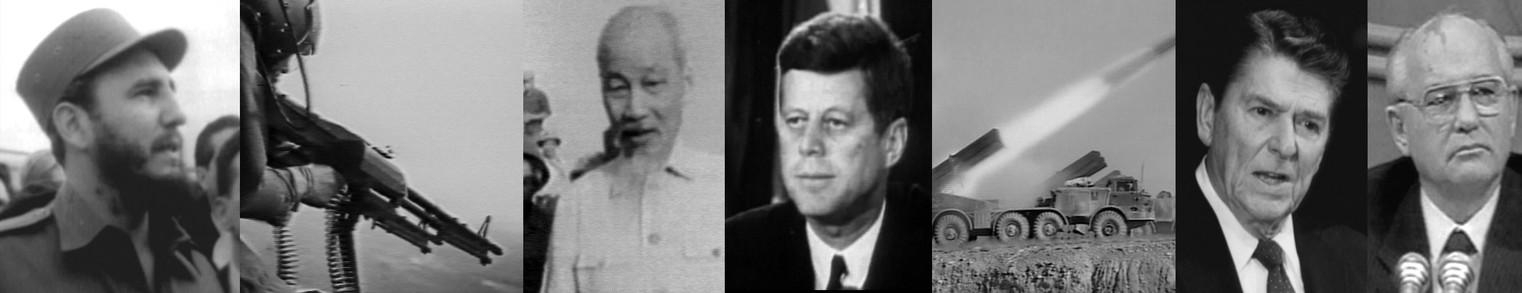
DETENTE
-Cooling off or relaxation time of the Cold War
-U.S. tries to limit the expansion of communism without war

Slide 10
Cold War Goes Global
U.S. begins to build military bases around the world
Mini-conflicts occur in Asia and Africa
Both countries get involved to keep as many countries as possible on their side
Cuba (with leader Fidel Castro) becomes Communist
U.S. worried about Communism so close to home

Slide 11
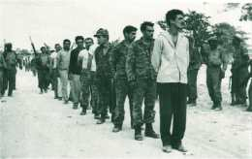
1961 - Bay of Pigs
U.S. president John F. Kennedy decides to invade
the invaders surrender on April 20 after three days of fighting.
1962- Russia sends nuclear weapons to Cuba
U.S. blockades Cuba so no more shipments can come in until all weapons are removed
World was at risk of nuclear war until Russia decided to remove the weapons after a few days
Captured Cubans

Slide 12
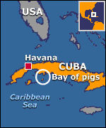
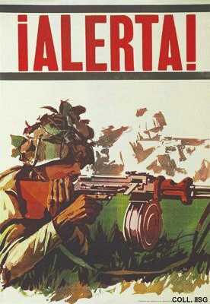
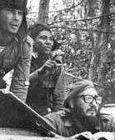
Bay of Pigs Debacle (1961)

Slide 13
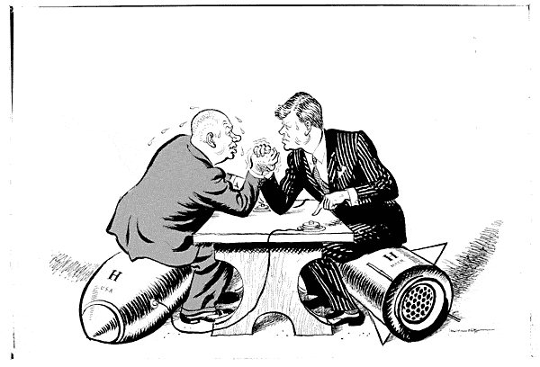
Cuban Missile Crisis (1962)
We went eyeball-to-eyeball with the Russians, and the other man blinked!

Slide 14
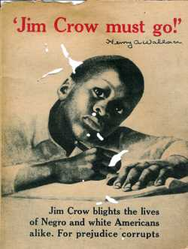
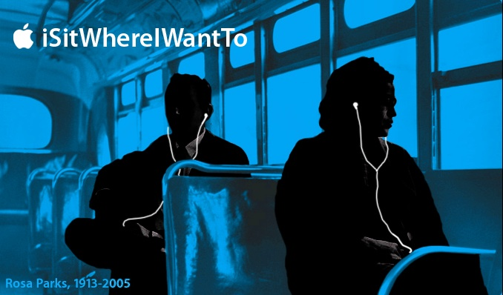
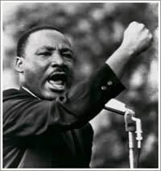
Page 976
Section 2 Democratic Countries Prosper

Slide 15

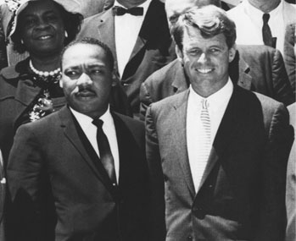

Economic BooM
U.S. was in good shape after World War II
Most people lived comfortably
Provided materials for others in the world
Opportunities for all Americans now
Marshall Plan [1948]

Slide 16
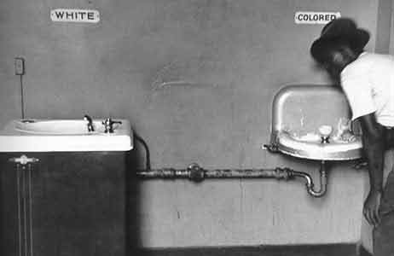
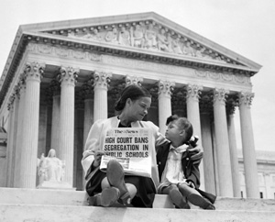
Civil Rights Movement
Segregation and discrimination still existed for minorities
“Separate but equal” facilities were okay until:
1954 Brown v. Board of Ed. (desegregated schools)

Slide 17
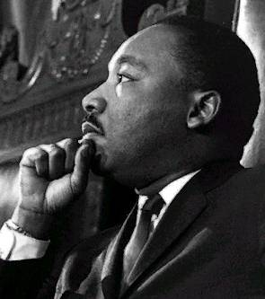
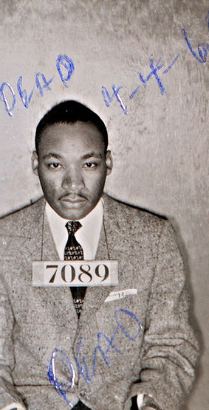
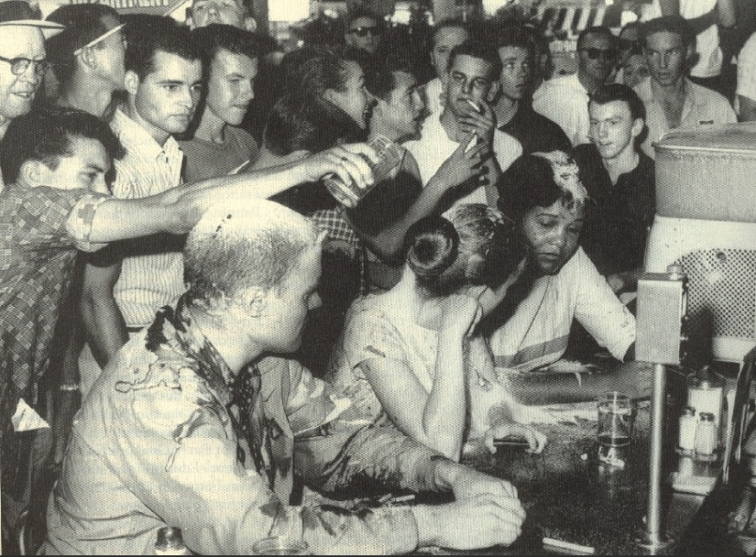
Civil Disobedience
  “We know through painful experience that freedom is never voluntarily given by the oppressor, it must be demanded by the oppressed.” MLK Jr.
In 1957, Martin Luther the King Jr. helped found the Southern Christian Leadership Conference (SCLC).
  group that used power of Black churches to organize non-violent protests for equal rights
  believed in the philosophy used
  by Gandhi in India known as
  nonviolent civil disobedience
  The televised segregation violence led to mass public sympathy
  The Civil Rights Movement became the most important political topic during the early 60’s
Notes:
Civil Disobedience is the refusal to obey civil laws in effort to promote change. Usually involved in changing government policy or legislation, Civil Disobedience is characterized by passive resistance or other nonviolent means. The idea of nonviolent civil disobedience was developed by Gandhi in the struggle for Indian Independence. Martin Luther King Jr. brought the idea of nonviolence to the United States in a strong way. King understood that protesting in non violent ways would ultimately attract the sympathy of people all across the nation. He was right. The televised media coverage of many African American marches and rallies made the Civil Rights Movement important on both a national and global level.
picture.: www.answers.com
<http://commons.wikimedia.org/wiki/Image:Mlkingmug1.jpg>

Slide 18
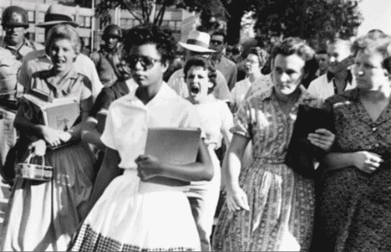
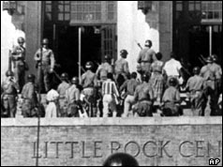
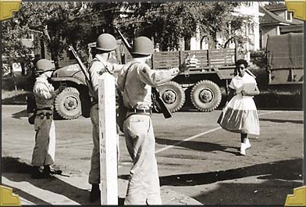
“The Little Rock Nine”
-Nine black students denied entry to school by Governor
-U.S. government sends in military to allow students in and for protection
Central High School, Little Rock, Ark

Slide 19

-women’s rights movement for equality as well
-most democratic nations prospered (Japan, Britain, W. Germany)

Slide 20
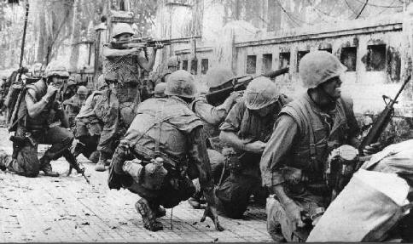

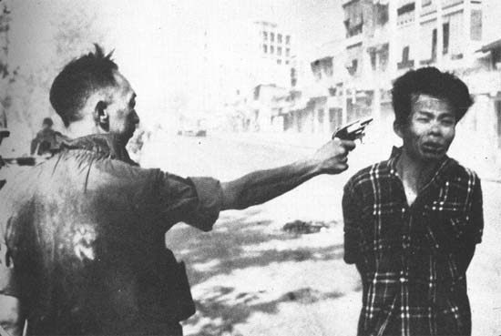
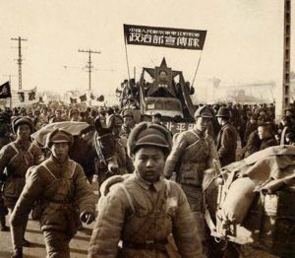
Section 3 Page 985
Communism in Asia

Slide 21
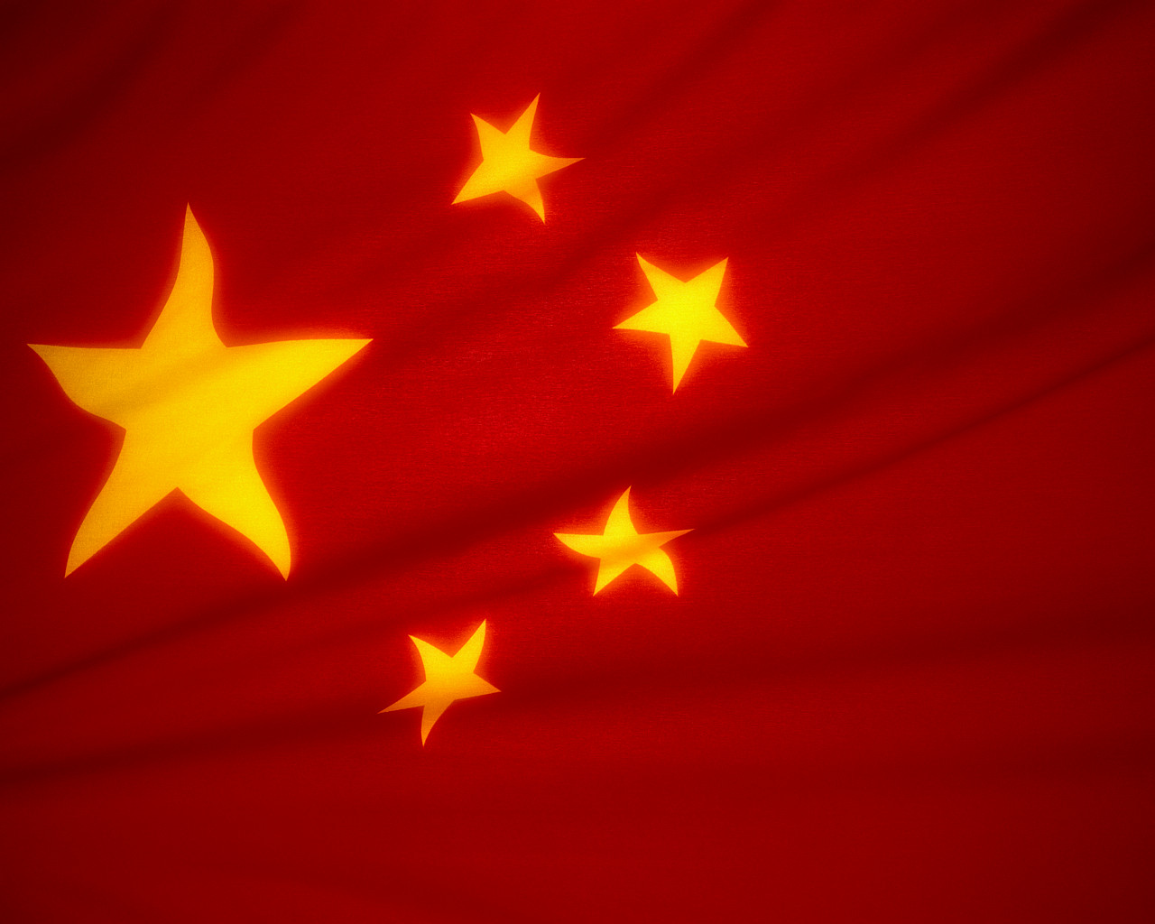
China becomes Communist
Taken over by Mao Zedong
Does not ally with Russia though
Old Chinese government forms country of Taiwan

Slide 22
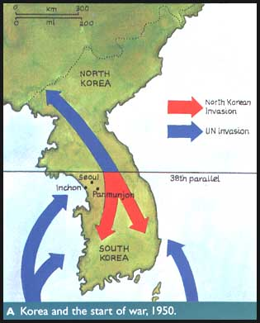
Korean War
-Korea divided into North (communist) and South (democratic)
-N. Korea invades the South to reunite Korea and make it all communist
-S. Korea with U.S. help fights them off
-Remains separated today

Slide 23
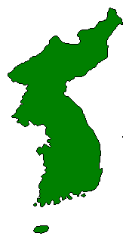
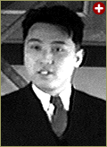
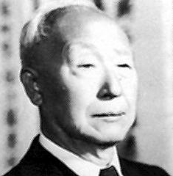
The Korean War: A “Police Action” (1950-1953)
Kim Il-Sung
“Domino Theory”
If one nation becomes communist, they will all become communist
Syngman Rhee

Slide 24
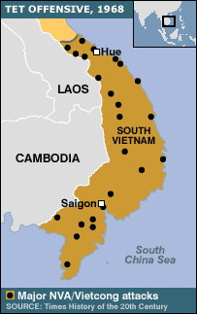
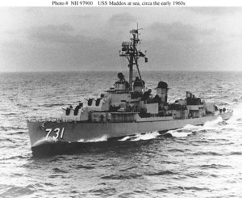

Section 4 Page 992
War in Southeast Asia

Slide 25
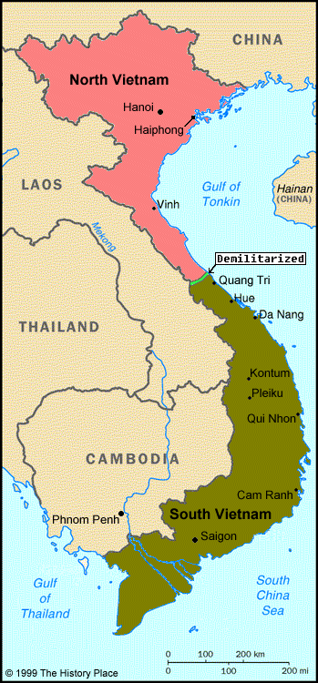
Vietnam War
Vietnam was controlled by communist leader Ho Chi Minh
Split up during Cold War
North was communist, South was not
Many Vietnamese want to be put back together
They fight to push U.S and other foreigners out

Slide 26
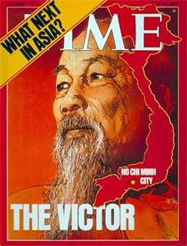
Quotes from Ho Chi Minh
“The Vietnamese people deeply love independence, freedom and peace. But in the face of United States aggression they have risen up, united as one man.”
“You will kill 10 of our men, and we will kill 1 of yours, and in the end it will be you who tire of it.”

Slide 27
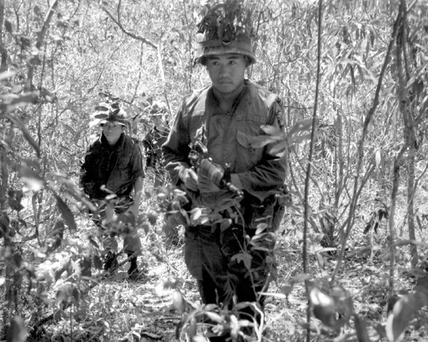
Guerilla Warfare
U.S. sends over 500,000 troops to help S. Vietnam
Russia and China give $ and weapons to
N. Vietnam
Viet Cong (communist rebels) hid in jungles, swamps and tunnels.

Slide 28
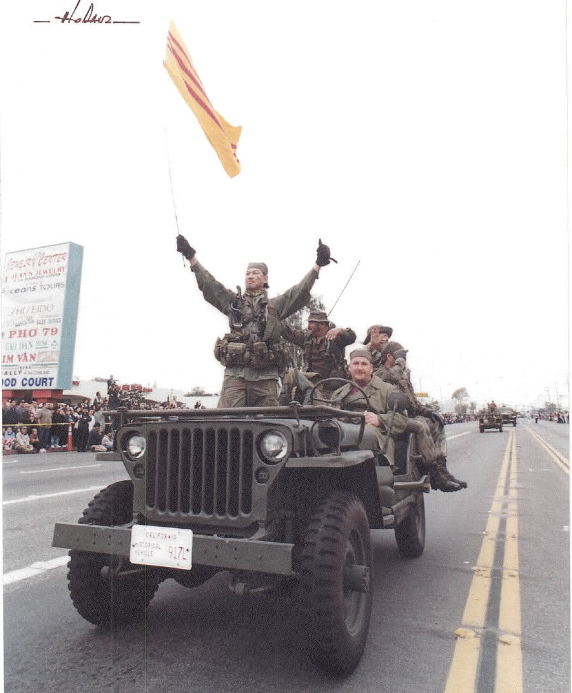
U.S. Withdraws
U.S. wins most of the battles
Suffers heavy losses however without gaining much
Many people oppose war at home
U.S. leaves, N. Vietnam takes over

Slide 29
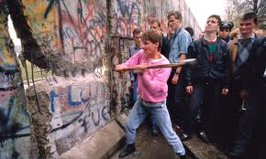
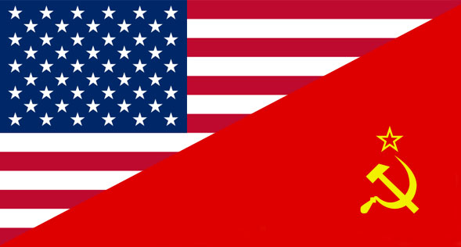

Section 5
The Cold War Ends
p. 1000

Slide 30

Command Economy
The government makes all economic decisions
Soviet Union uses this to control citizens, limits freedom
People had inferior products and saw no improvement
Standard of living was low
1985, new leader Mikhail Gorbachev comes to power
Ends censorship and restructures government for more openness (Glasnost)

Slide 31

Soviet Union Falls
*1991, Soviet Union breaks apart into 12 separate countries
*Many Nationalist groups call for independence
U.S. is the only “superpower” left after winning the Cold War.

