Slide 1

Ancient Rome and Christianity
Chapter 5
Section 1 pg. 150

Slide 2
Rome
located in the middle of Italy
many different groups of people made up Italy at this time
Romans learn from the Etruscans to the north
(building, farming, alphabet)

Slide 3
2 Types of Citizens
1. patricians – upper class, wealthy, owned land
2. plebeians – regular citizens, little power

Slide 4
Roman Government
Take over the Etruscans (509 B.C.) and start a:
Republic – government run by the people
Senate – 300 members, patricians only, ruled for life
Consuls – 2 patricians elected every 2 years to supervise gov. / army
Dictator – absolute ruler, used in time of crisis, 6 months only
Tribunes – elected by plebeians to protect their rights
eventually plebeians entered higher offices and gained power
Twelve Tables – first set of written Roman laws, protected all citizens

Slide 5
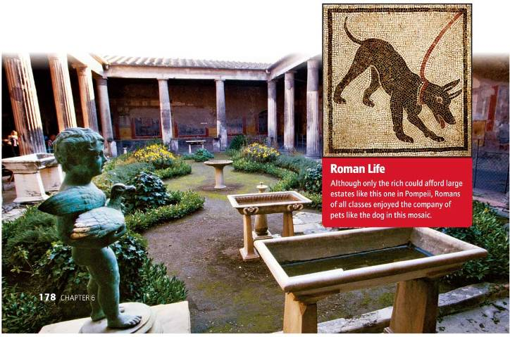
Family Life
-father was head of household, absolute power over the family (by law)
-education was very important, everyone was being educated
-believed in many gods/goddesses

Slide 6
Growth
military
conquering
legion – armies made up of approx. 5,000 soldiers
divided into centuries – 80 men with a specific job/skill
armies of citizens
conquered all of Italy by 270 B.C.
conquered people expected to be loyal to Rome and cooperate
road system built to connect empire, soldiers spread throughout also
Roman language and customs spread

Slide 7
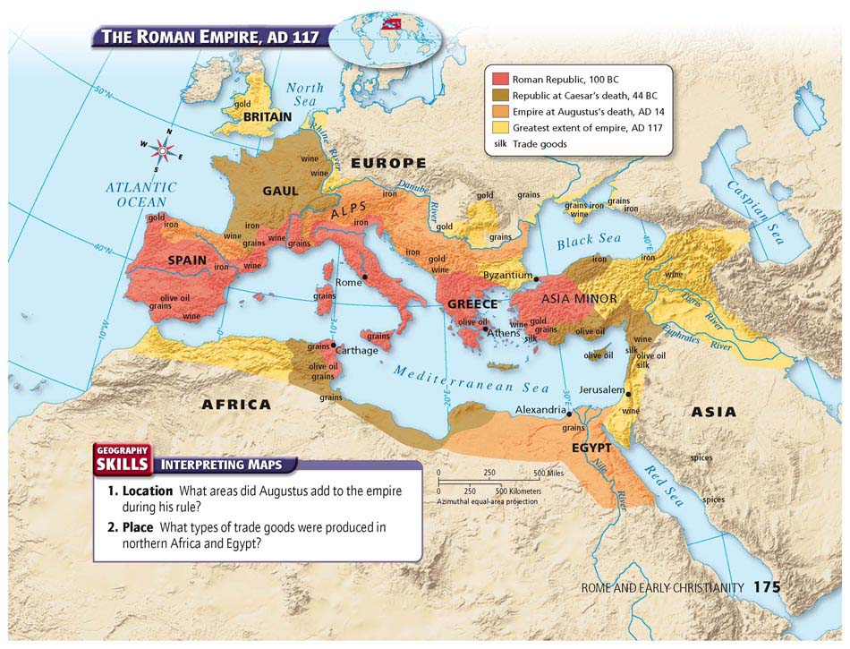
Section 2 p. 155
The Roman Empire

Slide 8
Punic Wars (Rome vs. Carthage)
Rome wanted to expand outside of Italy, spread out around the Med. Sea
run into an enemy in Carthage (N. Africa)
3 separate wars fought for control of the Med. Sea and its trade value
Carthage led by Hannibal, great military leader, used elephants in his army
eventually defeated by Scipio or Rome and Carthage was destroyed
Rome controlled the Med. Sea

Slide 9
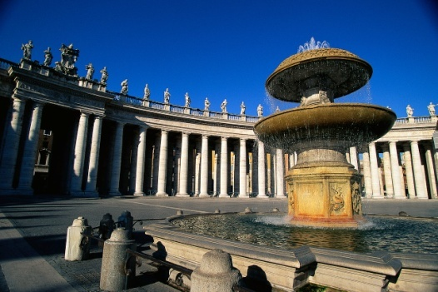
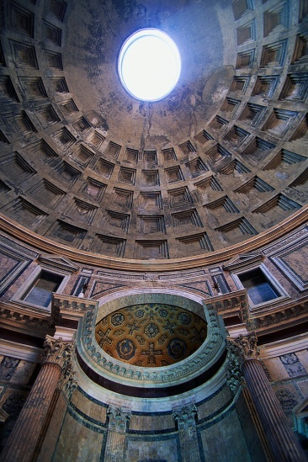

-imperialism – country taking over foreign land or people for their benefit.
-spread out empire in all directions
-more money and goods come to Rome now
-slaves (1/3 of population) used to build roads and buildings
-gap between rich and poor (1/4 people) increased
-riots and protests occur, many civil wars break out

Slide 10
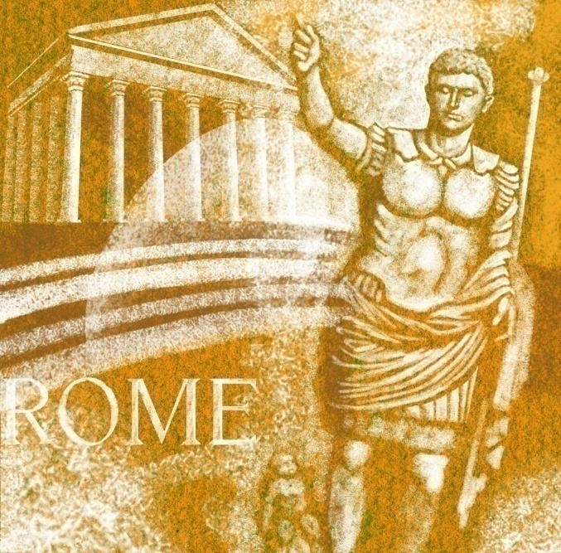
Julius Caesar
-becomes dictator during civil wars
-gives jobs/land to the poor, made more people citizens
-Senators fear he is taking too much power
-assassinate him by stabbing on the Senate floor

Slide 11
Pax Romana (Roman Peace)
200 years of Roman Peace (golden age)
Augustus – takes over as dictator, continues reforms of Julius Caesar
-organizes government, most people happy now
many Caesars (emperors) follow, some good and some bad
trade and wealth greatly increased from Africa/Asia
ideas/information also grows

Slide 12
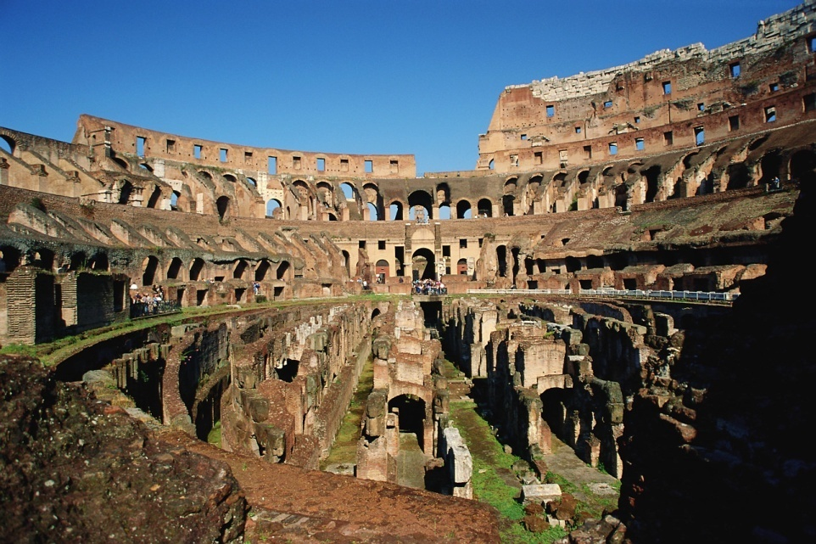
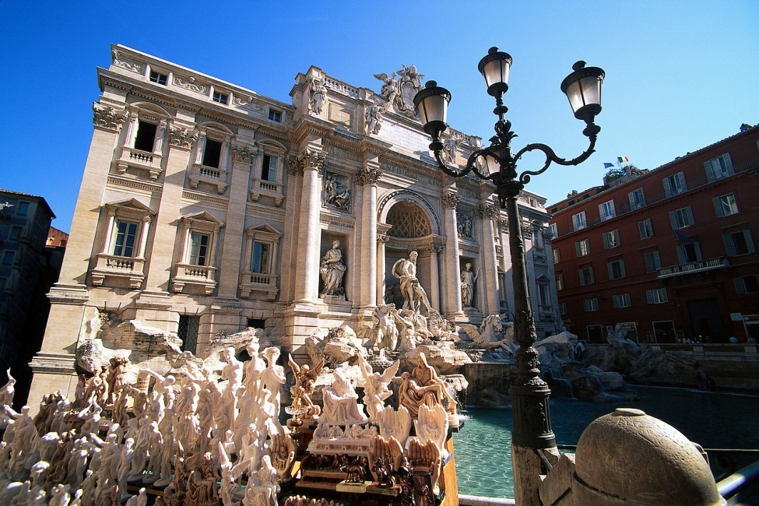
Section 3 p.161
Roman Achievement

Slide 13
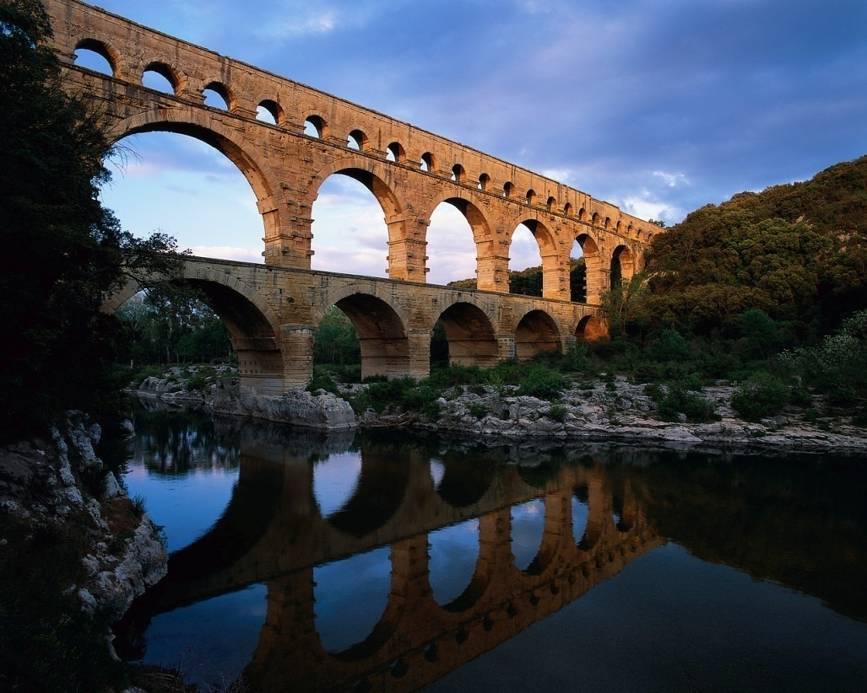
Greco-Roman Culture
aqueducts – structures built to carry water to cities from far away
used to sustain city life
washes out filth, baths created (social gatherings)
-blending of Greek, Hellenistic and Roman customs
-built roads, bridges, palaces, temples and stadiums using concrete
-created the arch, dome and vaulted ceiling

Slide 14
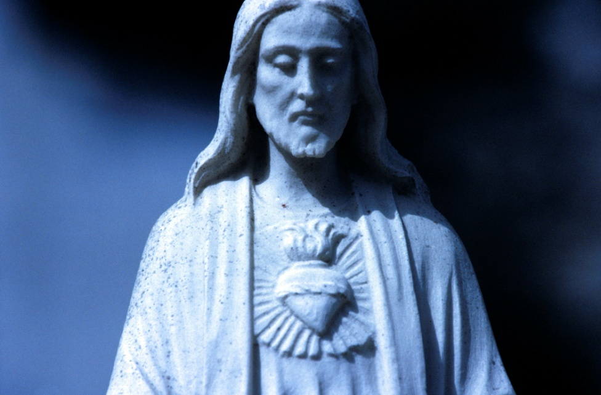
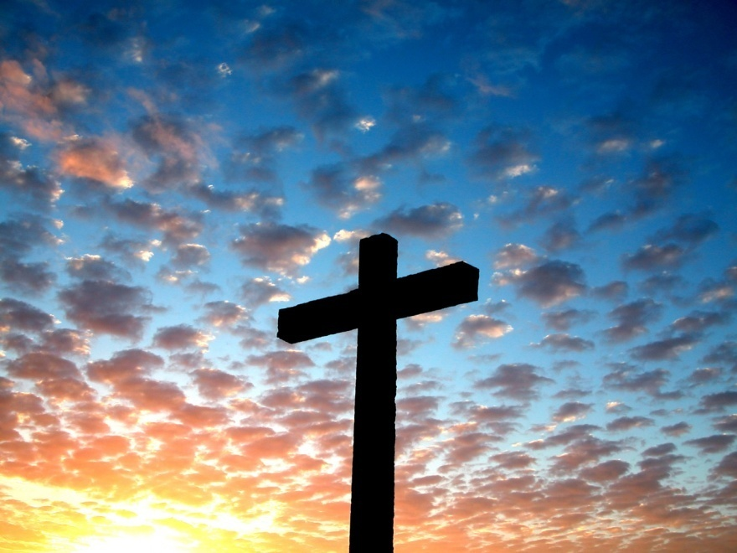
Section 4 p. 166
The Rise of Christianity

Slide 15
Religious History
-traditionally Romans believed in many gods (mythology)
-new religions were allowed as long as they still honored Roman gods
-Judea - (home of the Jews) conquered by the Romans
-believed in one god
-most Jews accepted being controlled by Rome
zealots - wanted to revolt against Rome and their religious practices
others thought a messiah (savior) would come to free them
Romans crush all Jewish revolts, many leave Judea and spread throughout the Mediterranean area

Slide 16
Jesus Christ
spreads easily by road and across the seas
Poor people/slaves accept it because it preached equality
meet resistance from Rome, Christians blamed for many things
suffer persecution, many become martyrs – people dying for what they believe
Emperor Constantine finally accepts Christianity (313 A.D.)
Christian churches built and the religion becomes organized
begins preaching and has many followers called apostles
many thought he was the messiah to save the Jews from the Rome
people attracted to his message of eternal life/love/justice/service
older Jewish leaders and the Romans see him as a threat
he was executed by crucifixion
-many disciples (followers) continued to spread Christianity

Slide 17
Section 5 p. 173
Rome Falls

Slide 18


Roman Problems
-Pax Romana ends due to governmental problems (emperors overthrown/killed), inflation, increased poverty)
Diocletian – emperor who splits Rome into 2 parts and makes reforms (changes) to try and save the empire
Constantine – more reforms, moves capital away from Rome to (Constantinople)
these changes helped temporarily

Slide 19
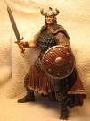
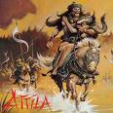
The End of Ancient Rome
Barbarian attacks
Why did rome fall?
Rome faced attacks from outsiders (barbarians)
the Huns, led by Attila, from Asia and others from the north and west enter the empire and take over
Attacks from outsiders
2. Army weakened (used outside mercenaries)
3. citizens apathetic (lazy, uninterested in improving)
4. civil wars (no leadership or unity)

