Slide 1

Early American Civilization
Chapter 6
Page 186

Slide 2
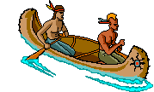
The First Americans
came from Asia
during last ice age, sea levels dropped and land connected
land bridge formed called Beringia
followed animals into the Americas
hunted/fished for food, nomadic lifestyle

Slide 3
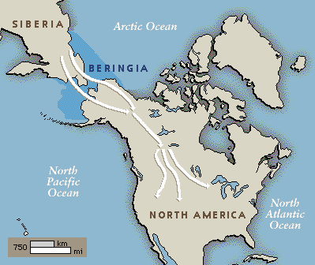
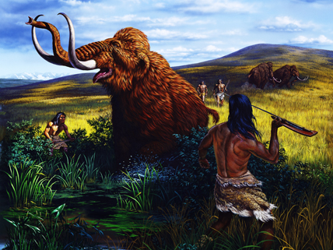
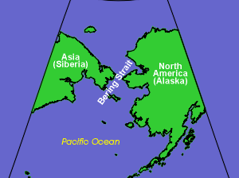
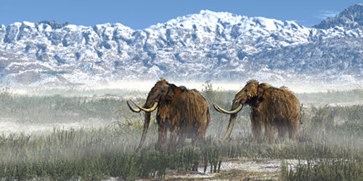
The BERING LAND BRIDGE
MOVIE LINK (click me)

Slide 4
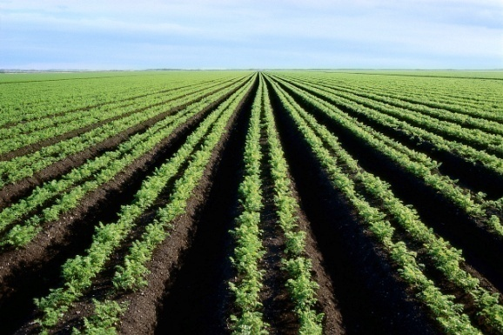

Birth of Agriculture
-started to settle down once they learn to farm (agriculture)
-more stable food source, cities/population grow, more time for other skills
(art, building, tools, technology)
Mesoamerica – land that is now Mexico and Central America, first settled groups are here

Slide 5
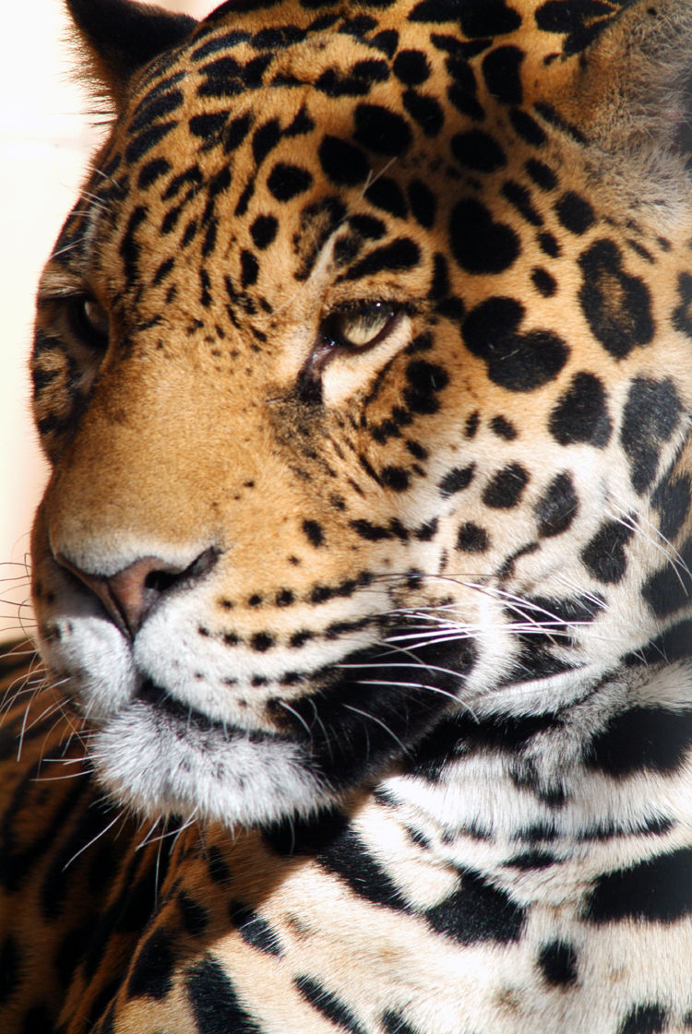
Olmecs
first builders (built burial mounds, pyramids, monuments)
known as the “mother culture” because they influenced other groups
worshiped the jaguar
invented a calendar, made artwork, carved hieroglyphics in stone

Slide 6
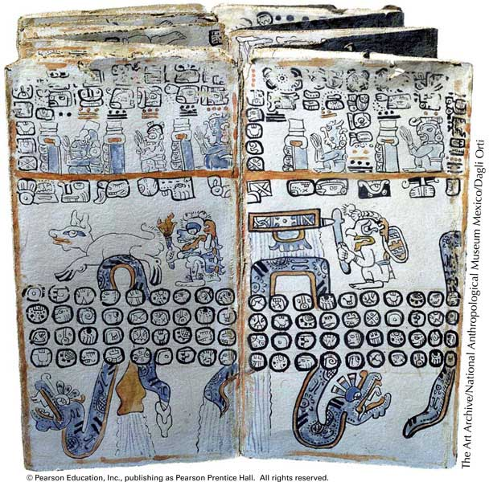
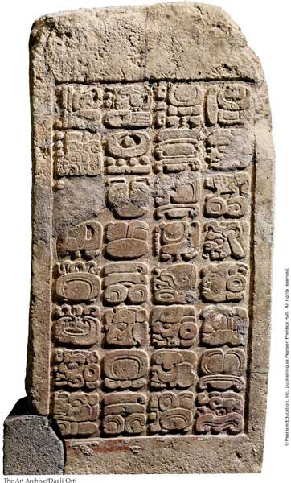
Mayans
lived in Yucatan peninsula of Mexico
learned from the Olmecs, excellent farmers
developed into individual city-states, not an empire
had social classes and cities were linked by trade
worked with math and astronomy, accurate 365 day calendar
advanced writing system of 800 glyphs (symbols), used stone or a bark paper book called a codex
worshiped many gods
practiced bloodletting and human sacrifice

Slide 7
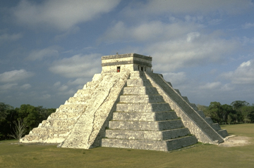
Aztecs
settled in the Mexico City area, capital Tenochtitlan (island in the middle of a big lake)
emperor ruled over the empire, different social classes also
built floating gardens called chinampas
massive human sacrifice (daily), usually of conquered enemies

Slide 8
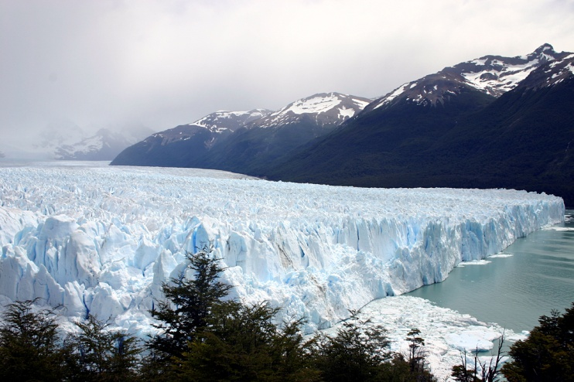
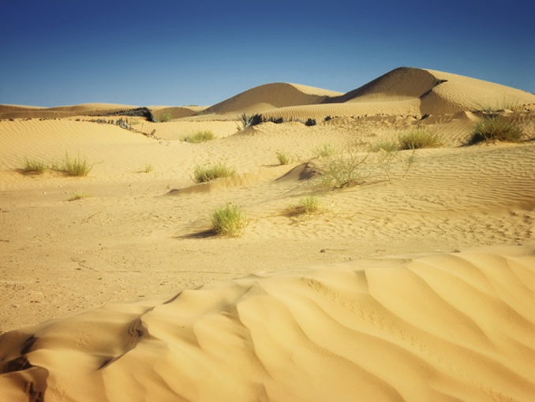
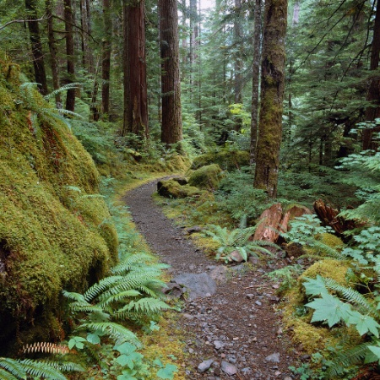
South American Cultures
Section 2 pg. 195

Slide 9
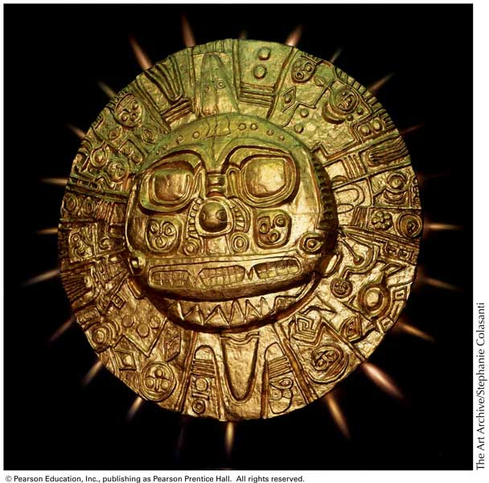
Cultures of the Andes Mountains
Western coast of
S. America
Chavin – mother culture of S. America, very religious
Moche – developed irrigation systems for farming
built roads, very wealthy (gold, silver, precious stones)
used sun-dried bricks of clay/mud called adobe to build
Nazca – made huge drawings on the earth (geoglyphs) for their gods

Slide 10
Incas
learned from earlier groups, most powerful
capital was Cuzco, emperor was Pachacuti
took over neighboring groups
all people had to pay a mita – labor tax
united everyone by language (Quechua) and religion
messages sent by chasquis – system of runners/messengers
no writing system
learned to work with metals and weave cloth

Slide 11
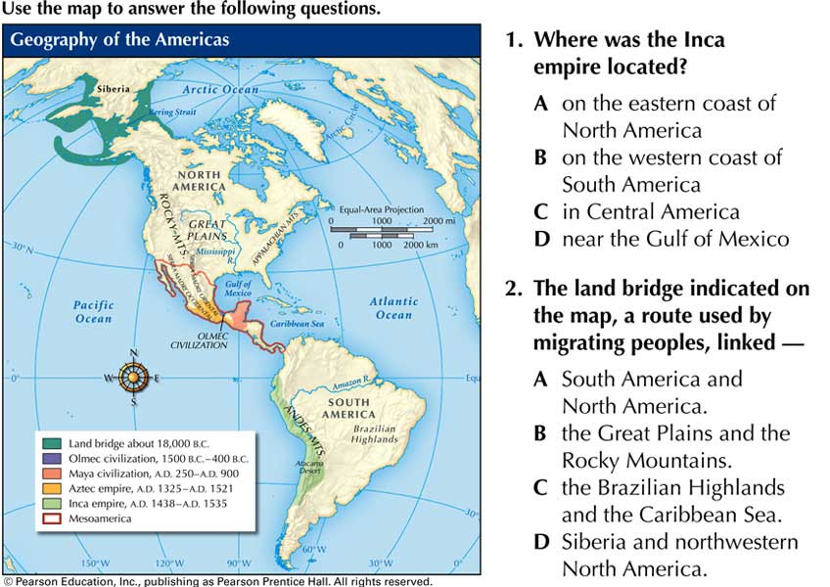
Civilization of the Americas: Section 1
Progress Monitoring Transparency

Slide 12
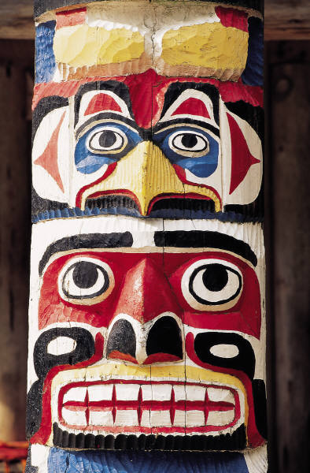
Section 3 pg. 201
Early North Americans

Slide 13

Ten different culture areas
SOUTHWEST
first to develop farming
built irrigation systems and pueblos – large apartment homes made of stone and clay (adobe)
some groups (Anasazi) built homes in caves or beneath cliffs
EAST
built burial mounds, great traders (items found from many regions)
formed alliances to keep the peace (Iroquois League)

Slide 14

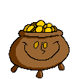
NORTHWEST COAST
hunted whales, different social classes
Potlatch – ceremony in which gifts are given to guests to show off wealth
Inuit (Eskimos)
lived in igloos on frozen land of northern Canada
hunted/fished for food

Slide 15
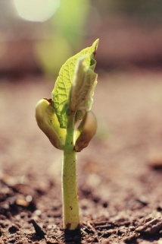


Common Beliefs
1. Polytheistic
2. Respect for the land
3. Family most important (totems were symbols of unity)

