Slide 1

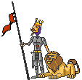
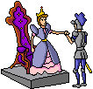

Chapter 7
The Rise of Europe
Page 214

Slide 2
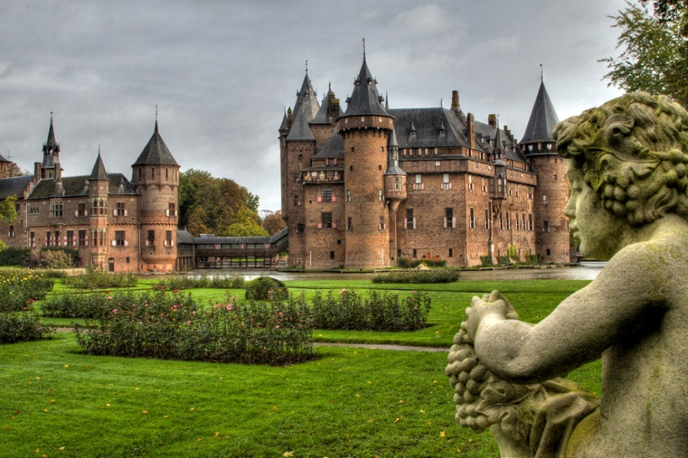
500-1500 A.D. "The Dark Ages"
no longer unified, invaders enter Europe
trade declines, loss of learning, common language lost
land divided into small kingdoms instead of one big empire

Slide 3
Carolingian Dynasty
Largest kingdom in this time period, ruled by a family known as the Franks
Conquered Gaul and renamed it France
greatest ruler was Charlemagne (Charles the Great)
accepted and spread Christianity as well as education
added new lands, reunited much of Europe
empire collapsed after his death, invasions from Vikings and Magyars also

Slide 4
Section 2 Page 219
Medieval Times (The Middle Ages)

Slide 5
Feudalism
people needed protection from barbarian attacks
they turned to local rulers with castles and their own armies for protection
this leads to :
based on mutual obligations (agreements to do things for each other)
Lord (king) – owned most of the land (manor), had his own castle and army
Vassal – received fiefs (land grants) from the lord in exchange for military service
Aristocrats – wealthy landowners and bishops (church officials)

Slide 6


Peasants
Knights
rode horses, wore armor, helped to protect a kingdom
trained beginning at age 7 as squires and pages
practiced warfare and gained experience in tournaments
followed the code of:
chivalry – brave, loyal and courteous, fight fairly, protect women
worked the land for the lord in exchange for food, shelter and protection (most of the population)
most were serfs – peasants not able to leave their land
suffered from hunger and disease at times

Slide 7
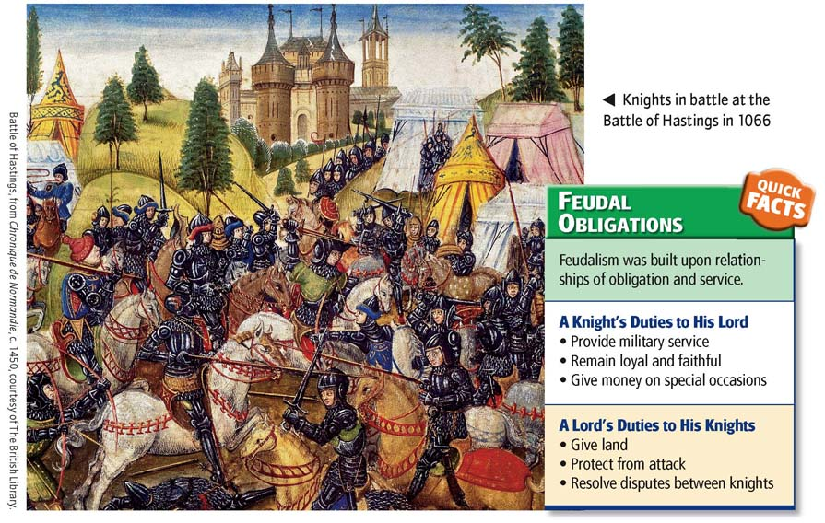

Slide 8
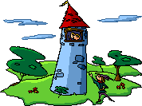
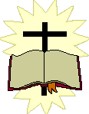





Manor
a lord’s castle and surrounding land
self-sufficient, produced everything that they needed
usually included a church, workshops, fields, cottages, pastures
troubadours – poets/musicians traveling around a manor

Slide 9
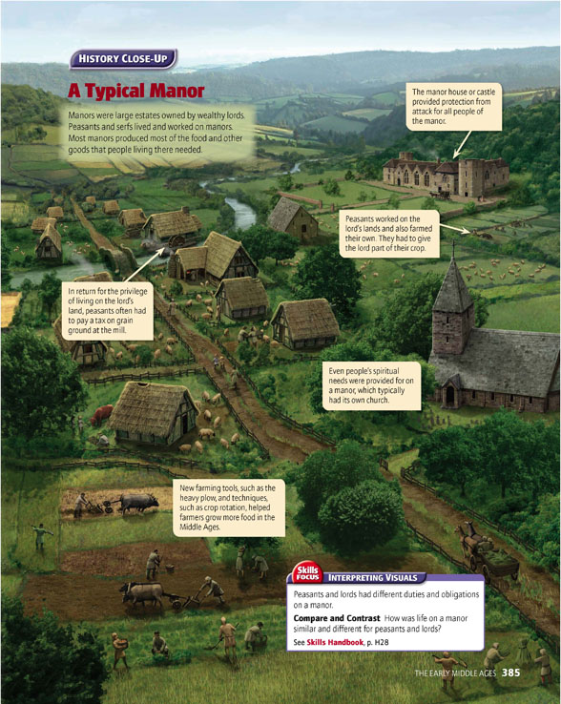

Slide 10
Section 3 Page 225
The Medieval Church

Slide 11
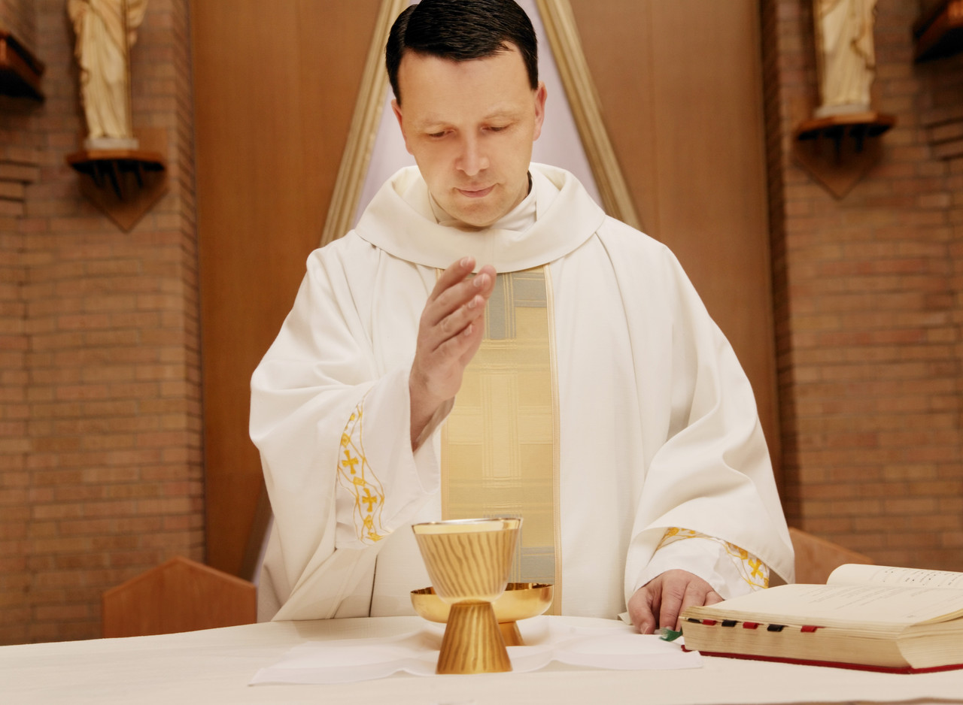
Christianity
was most important in peoples’ lives
Sacraments – religious ceremonies, felt they would achieve salvation (soul saving, eternal life with God)
monks (men) and nuns (women) devoted their lives to Christianity and serving others
-clergy – religious officials

Slide 12
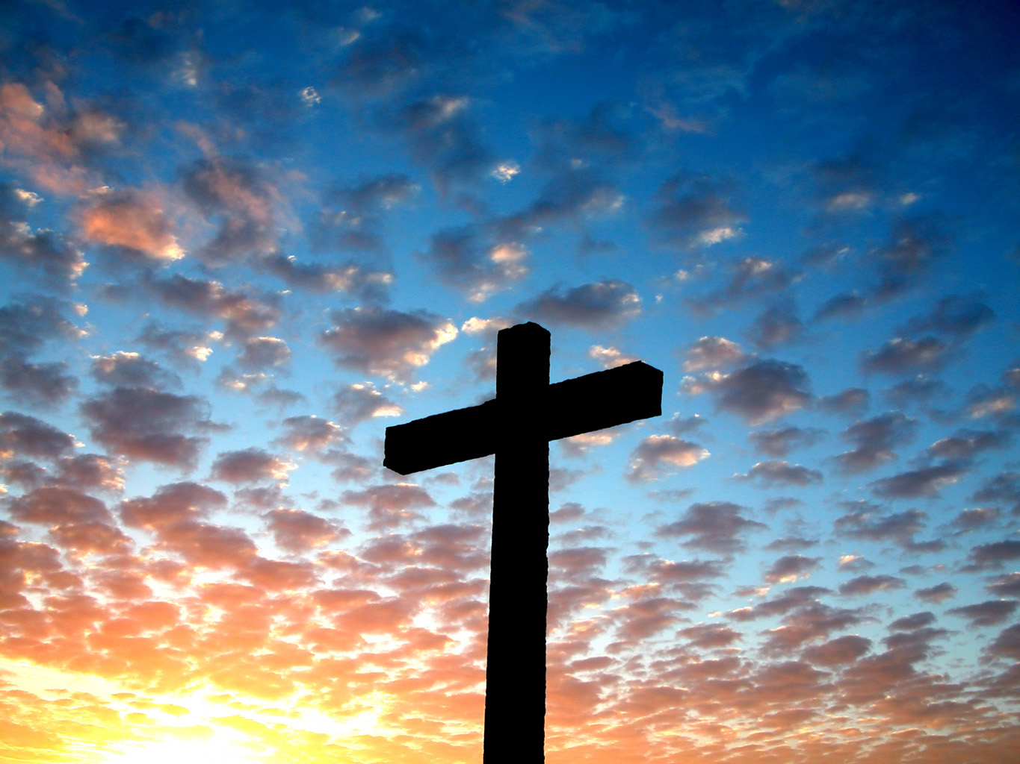

Pope
Punishments
the main leader of Christianity
also became a secular (outside the area of religion) leader
could control kings using:
canon law – laws of the Christian church
excommunication - banished from the church
interdict – no sacraments/religious events on a person’s land
some clergy members abused their power and were corrupt
Friars – travelling monks, gave up all of their possessions

Slide 13

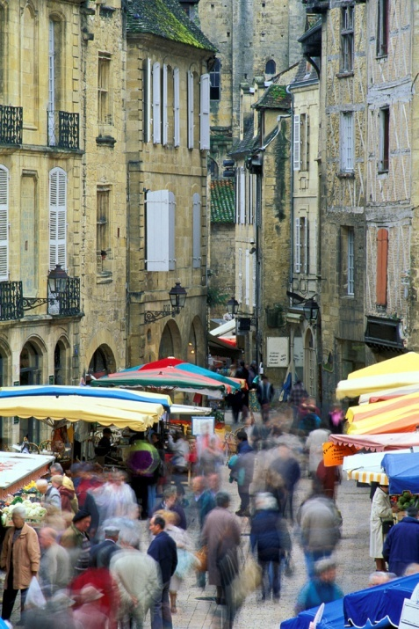
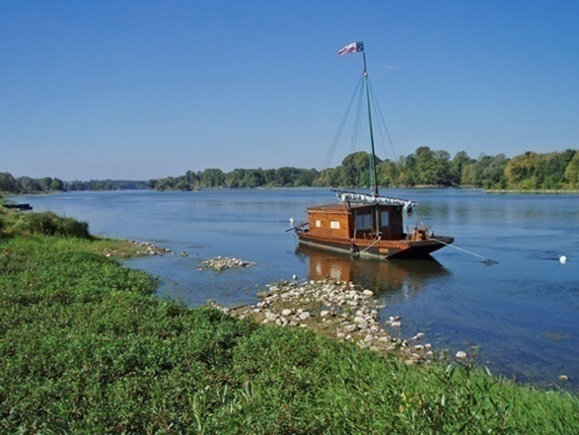
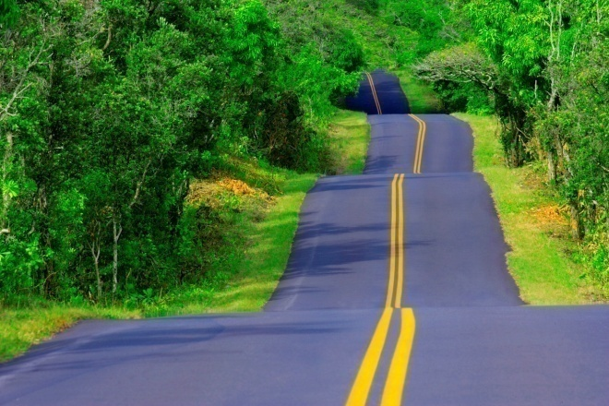
Section 4 Page 231
Economic Change

Slide 14
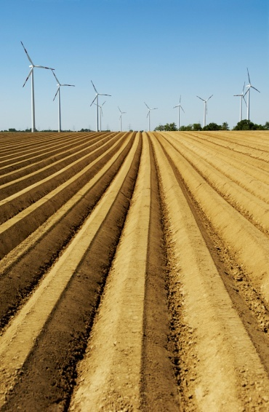
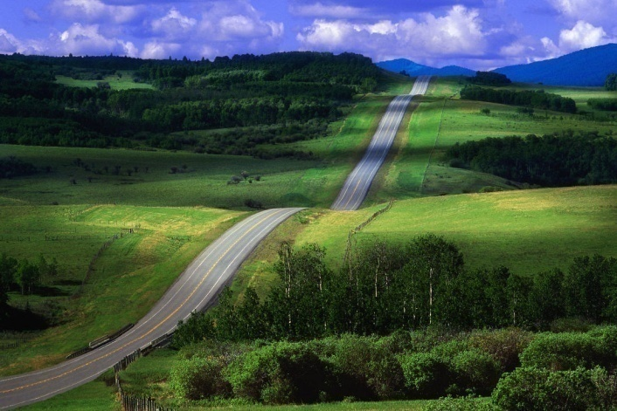
Improved Farming
Improved Trade
iron plows
use of livestock (horses, oxen)
three-field system (crop rotation)
results – more food, population grew
fewer barbarian attacks, safer to travel
better roads built
more use of money instead of bartering (trading)

Slide 15
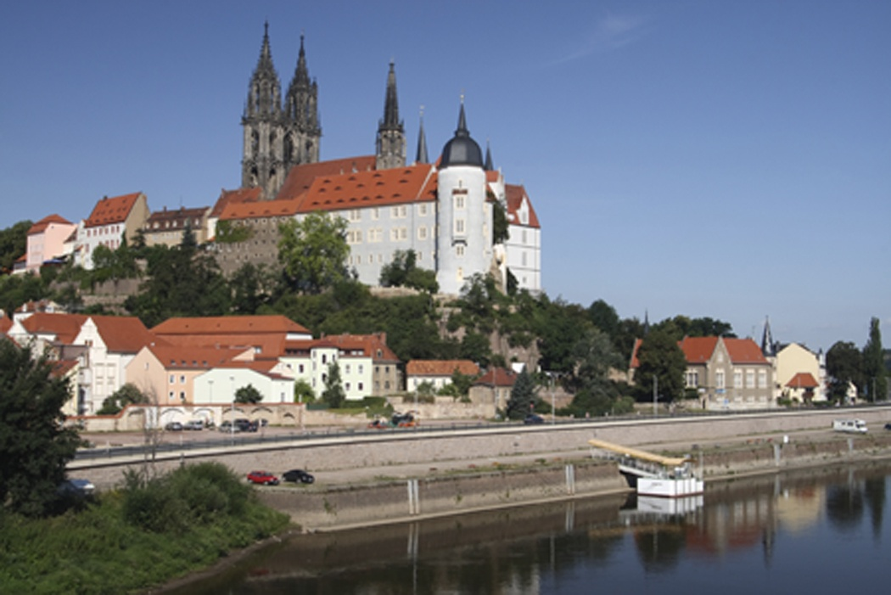
Cities
form as people gather in areas to trade
usually surrounded by walls for protection
crowded, narrow streets, fire always a threat
no sanitation (garbage collection) or sewer systems
feudal system begins to break down as many people leave their kingdom to move to cities

Slide 16
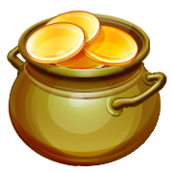
Middle Class develops
created from merchants and artisans (skilled workers)
earned money from new businesses
looked down upon by nobles and clergy
guilds – groups of workers with the same job or skill
set prices, ensured quality products
usually needed years of training as an apprentice
had to present a “masterpiece” to join

