Slide 1

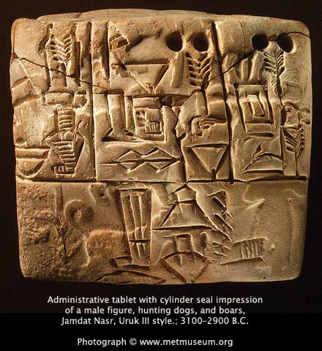
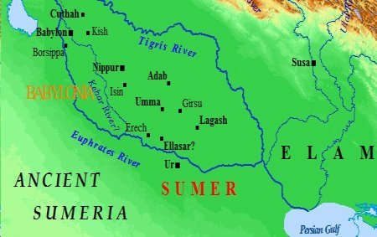
Chapter 2
The Ancient Middle East

Slide 2
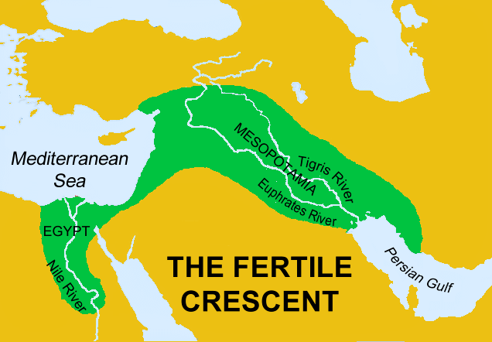
FERTILE CRESCENT
-area between Asia and Europe
-good soil for farming
-many different people migrate there
- lots of cultural diffusion

Slide 3
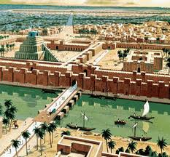
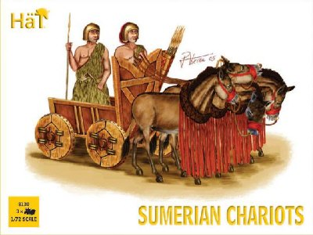
MESOPOTAMIA
-Area of land between the Tigris and Euphrates rivers
-World’s 1st civilization began there
(The Sumerians)
-controlled rivers to prevent flooding and help farming
-used clay bricks for building
-first to use wheeled vehicles

Slide 4
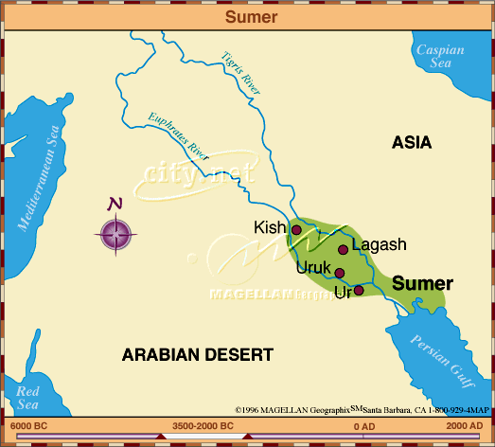
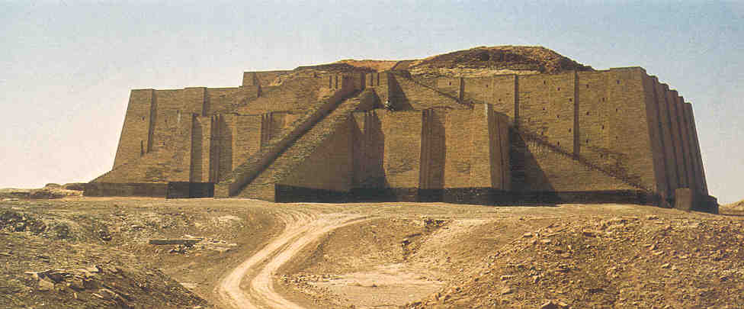
Sumerians
-invented the earliest writing, Cuneiform (p.33)
-studied astronomy and math
-told and wrote epics (long poems that tell a story)
-The Epic of Gilgamesh (p.35)
-developed different social classes
-most people were farmers
-polytheistic (worshipped many gods)
-believed in afterlife
-each city built a Ziggurat (temple) to please the gods

Slide 5
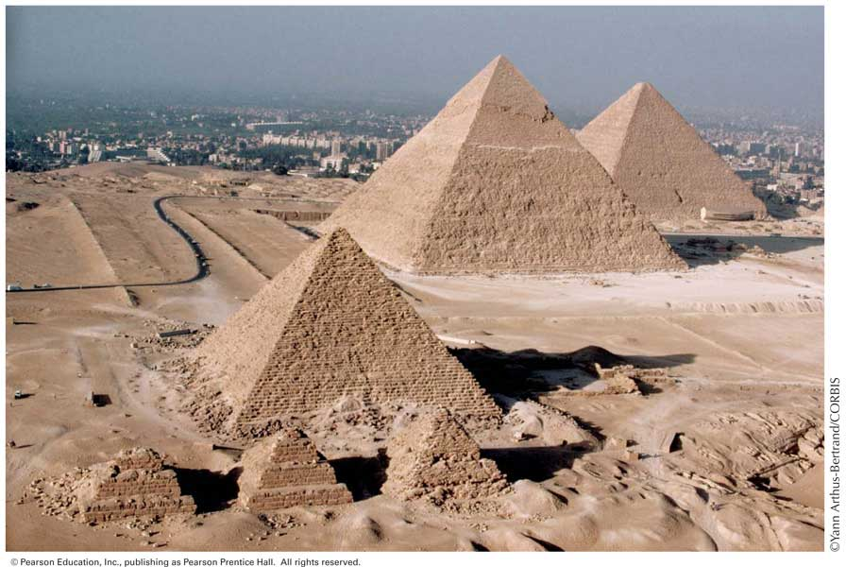

Section 3 pg. 44
Kingdoms of Ancient Egypt

Slide 6
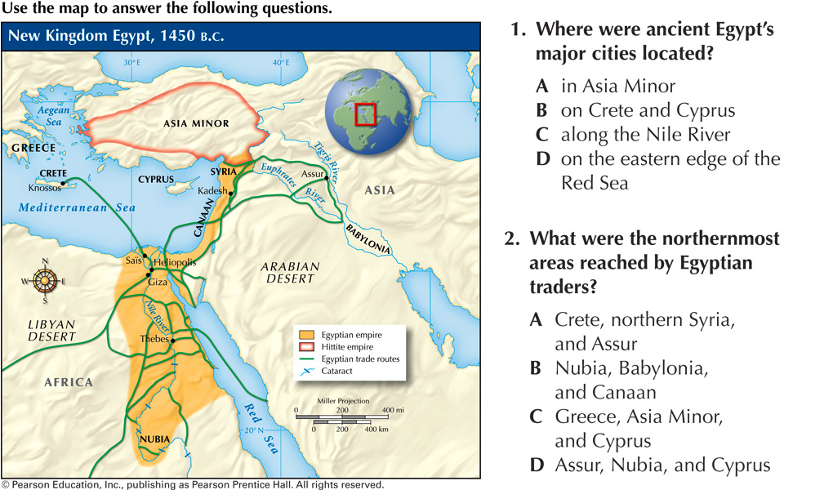
The Nile
-first settlers migrated here
-most of the land is desert
-flooding of the Nile allows for agriculture (farming)
-cooperation was needed to control the flood waters (ditches, dams, etc.)

Slide 7

Nile (continued)
-the Nile unites upper and lower Egypt (transportation/trade)
-capital was Memphis

Slide 8
History of Egypt
Old Kingdom
-ruled by pharaohs –Egyptian kings, treated like gods
-expected to treat people fairly
-used bureaucracy – different government jobs to organize and operate better
-included a vizier - (chief minister) – in charge of supervising
government workers and their activities
-pyramids built for the pharaohs
-believed in life after death, preserved bodies
(mummies) and items left for their new life

Slide 9

History of Egypt (cont.)
New Kingdom
-time of growth
-great pharaohs such as Hatshepsut, Thutmose III, Ramses II
-eventually rule ended after taken over by the Greeks in 332 B.C.
-

Slide 10
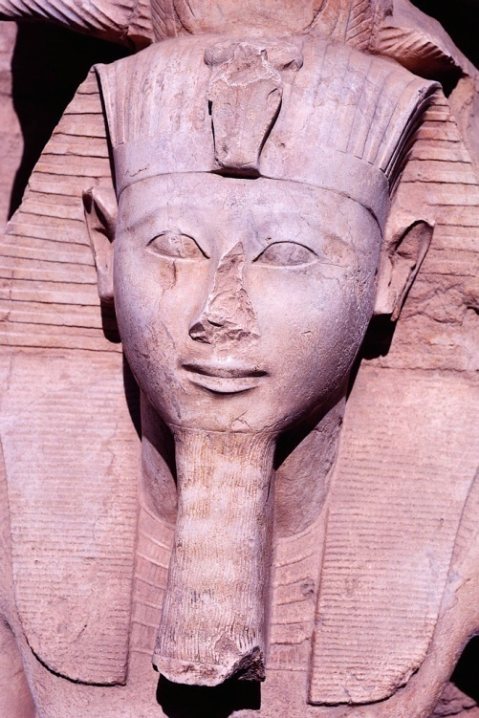
Section 4 pg. 50
Lives of Egyptians

Slide 11

EGYPTIAN RELIGION
-polytheistic
-main god was Amon-Re
-believed in the afterlife and had to please the god Osiris

Slide 12
Social Classes
1. Pharaohs
2. government officials/priests
3. merchants, scribes, artisans
4. peasants – workers (mainly farmers), some were slaves
Women treated nearly equally to men, unusual for an early civilization

Slide 13
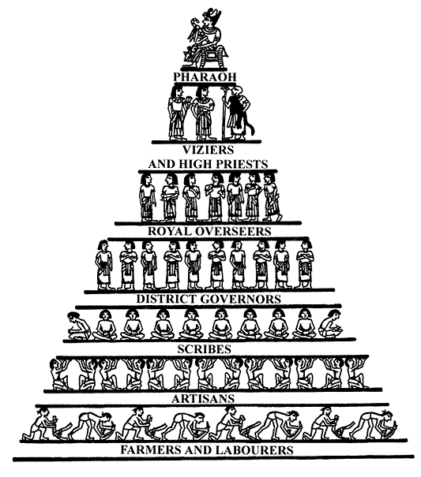
Egyptian Social Hierarchy

Slide 14
Accomplishments
written records developed through picture symbols(hieroglyphics) carved in stone
later developed hieratic and demotic writing (cursive script) written on
papyrus – early form of paper
archaeologists figured out the meaning of these symbols by decoding the Rosetta Stone (p.55)
Egyptians studied astronomy, medicine and math
also created paintings, sculptures, poems and folk tales

Slide 15
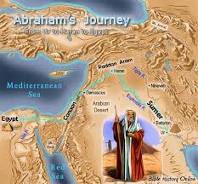
Judaism
Section 5
-The religion of the Israelites (Hebrews)
-Abraham is the father of Judaism
-Torah – sacred book of the Hebrews
-Monotheism – belief in one god
-eventually taken over and Jews had to leave (The Diaspora)
-today the country of Israel is home to Jews

