Slide 1
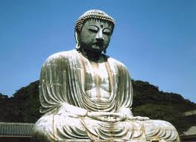
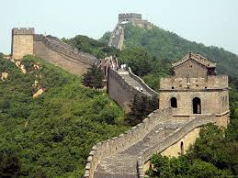
CHAPTER 3
Ancient India and China

Slide 2
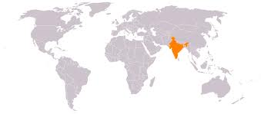
India
Hinduism
Polytheistic, main god was Brahma (creator)
Goal was to unite with Brahma
Took more than one lifetime (reincarnation)
Achieved through Karma
Believed in a caste system.
Buddhism
Started by Siddhartha (became the Buddha)
Only way to avoid pain/suffering is to follow the Eightfold Path
Goal is achieve Nirvana (unite with universe, end cycle of rebirth)
Both religions favored non-violence

Slide 3
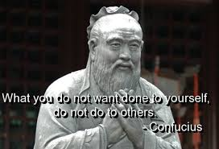
Dynasties of Ancient China
Shang Dynasty (1766 B.C.)
Organized all citizens together and formed government
Zhou (JOH) Dynasty (1122 B.C.)
Ruled by divine right (Mandate of Heaven)
Started Feudalism – local rulers owed service and support to the ruler
Confucius becomes popular during this dynasty
Achievements: silk, calendars, writing system

Slide 4
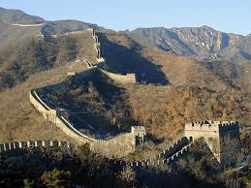
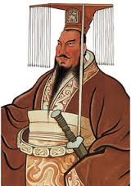
Qin Dynasty
-Strict, authoritarian rule
-Standardized weights/measures common coins, improved transportation
-Built the Great Wall

Slide 5
Han Dynasty (202 B.C.-220 A.D)
Time of expansion (adding new land)
Opened trade networks to the west (Silk Road)
Created civil servants – government officials win positions by merit (not family)
-Developed calendars, acupuncture and made paper from wood pulp.
-Eventually overthrown and China was broken into smaller kingdoms.

