Slide 1


Ancient Greece
Chapter 4 pg. 113

Slide 2
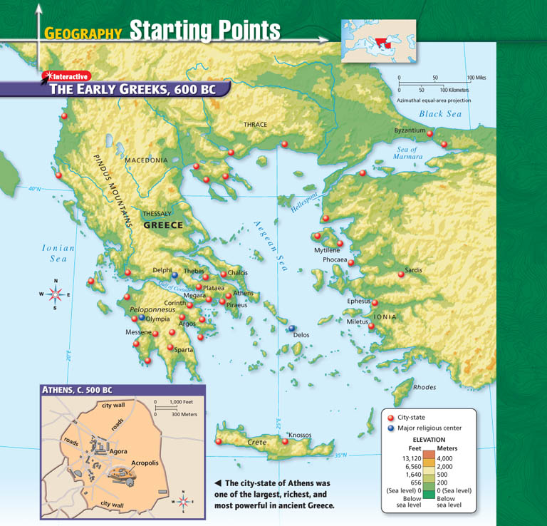
Where is Greece?
peninsula in the Mediterranean Sea
spread out, not united
mountains separated people also
little farmland/natural resources
water used for transportation/trade

Slide 3
Early People in Greece
Minoans (1600B.C. – 1500B.C.)
lived on island of Crete, capital was Knossos
learned ideas/technology from Egyptians and other early civilizations
grew due to trade instead of war
Mycenaeans (1400B.C. - 1200B.C)
conquered the Minoans
led by warrior-kings who built walls to protect cities
fought in the Trojan War (p.116)

Slide 4
The Trojan Horse
Neither the Greeks nor the Trojans seemed to be able to win the Trojan War until one of the Greek kings, Odysseus of Ithaca, had an idea. "Build a big wooden horse on wheels. Make it big enough for a bunch of Greek soldiers to hide inside." So the Greeks did. Then the Greeks all pretended to sail home (except the ones hiding inside the horse). They acted like they had given up and left but really they were hiding just around the corner.
Soon the Trojans found the horse. "What is it?" they asked each other (the Greek soldiers hiding inside kept very quiet). Then they found a Greek soldier hiding nearby. He said ,though this was part of the trick, that the other Greeks hated him and they had left him behind. So the Trojans asked him what the horse was for. He said it was an offering to the goddess Athena.

Slide 5
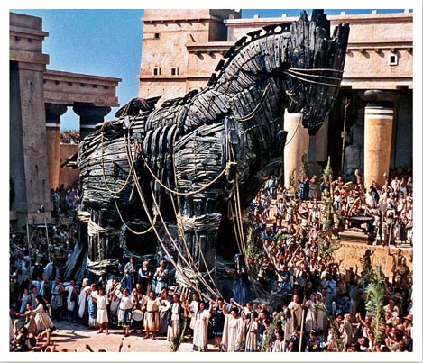
The Trojan Horse

Slide 6
The Trojan Horse (continued)
The Trojans didn't want to upset Athena so they rolled the big horse into the city of Troy. It was so big that it wouldn't go through the gate and they had to tear down a piece of the city walls to get it in. They left it at the temple of Athena and then the Trojans had a big party to celebrate the end of the war (still the Greek soldiers inside the horse kept very quiet).
Finally everyone fell asleep,and that was when the Greek soldiers came out of the Trojan Horse and killed the guards on the walls. They signaled to the other Greeks to attack Troy. They could get in now because the walls were torn down. There was a big battle and the Greeks won. All the Trojan men were killed and all of the women and children were taken back to Greece as slaves.

Slide 7
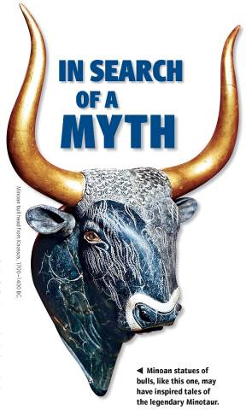
Dorians
-(1100B.C. – 900B.C.)
-conquered the Mycenaeans
-less advanced, no writing
-information passed on orally
-Homer – famous blind storyteller of
epics – poems that tell a story
-told the Iliad and the Odyssey

Slide 8
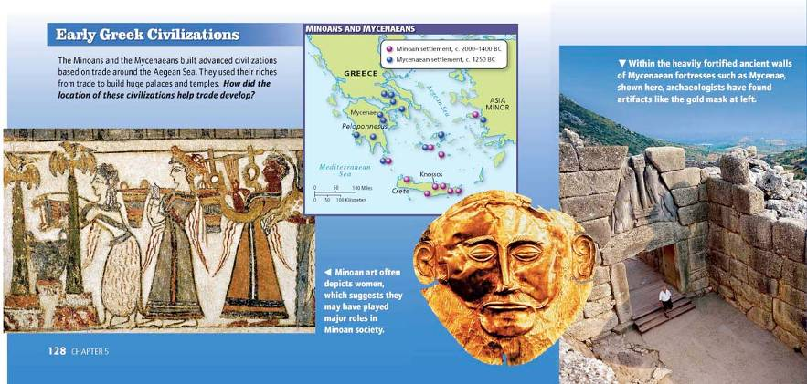
Section 2
Greek City States
(pg. 118)

Slide 9
Greek City-States
polis (city-state) - developed independently, each had its own government, laws and customs.
Life in the Polis
Infrastructure
Other Attributes
center of daily life, culture
Greeks fiercely loyal to their polis
Did not think of selves as Greeks, but as residents of their particular city-state
Polis built around high area, called acropolis
Acropolis used as fortification
Included temples, ceremonial spaces
Agora, public marketplace, below
Shops, houses, temples near agora
Gymnasium, athletes’ training grounds, public bath
Sturdy wall for defense surrounded polis

Slide 10
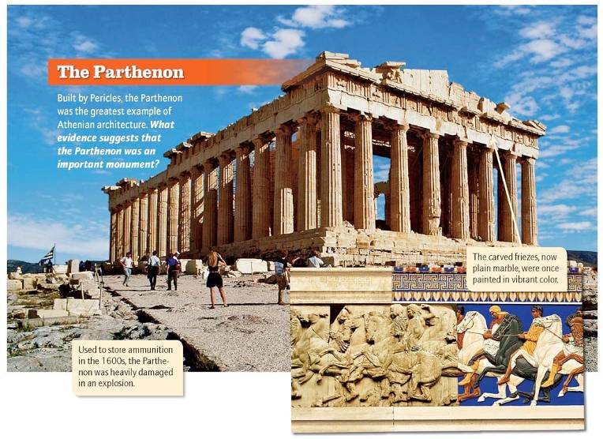
Types of Governments
1. Monarchy – ruled by a king/queen, rule stays in the family (hereditary)
2. Aristocracy – ruled by the small group of rich/wealthy citizens
(also hereditary)
3. Oligarchy – ruled by a small group of powerful, military people

Slide 11
Sparta
Beginnings
did not care about trade, wealth, individual rights or the arts
military/serving Sparta was most important
Spartans conquered town of Messenia, made people into helots
Helots
state slaves given to Spartan citizens to work on farms so citizens did not have to.
as result, Spartan citizens were free to spend time training for war
outnumbered Spartans 7 to 1, strictly controlled
War
boys began military training at age 7
Learned the phalanx fighting formation
became hoplites (foot soldiers) at age 20, served for 10 years

Slide 12
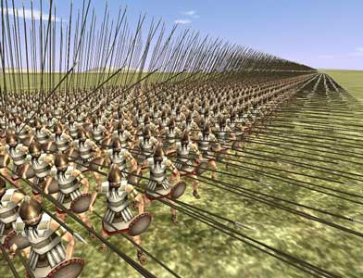
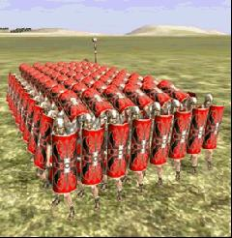
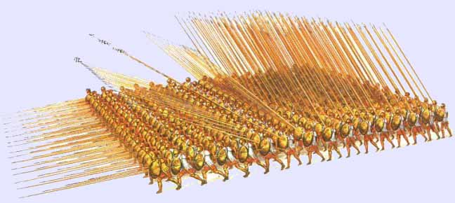
Phalanx
Soldiers would line up in a rectangular shape and have shields and spears on all sides of them for protection

Slide 13
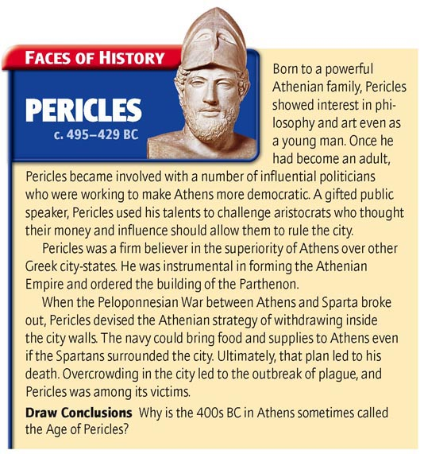
Athens
first ruled by tyrants – rulers who take power by force
government became a democracy(rule by the people)
limited to wealthy and citizens only (slaves, women, foreigners not citizens)
men allowed to be educated/think freely unlike Sparta

Slide 14
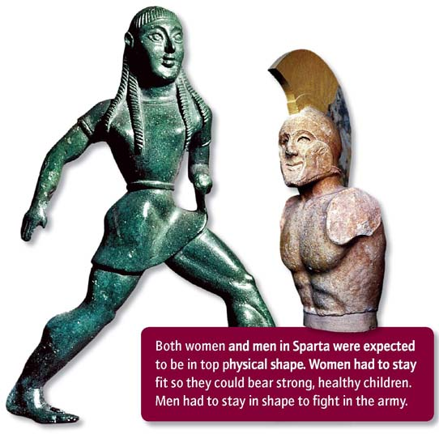
Section 3
Greek Conflict pg. 124

Slide 15
Persian Wars
-Persians entered Greece from the east looking for new territory
-Led by Darius (duh-RY-us) and his son Xerxes (ZURK-seez)
-Greeks see any non-Greek as barbarians (uncivilized people) and
want them out
-Athens attacked first but soon get help from other city-states including Sparta
-Greeks eventually defeat Persians using Athens’ navy and Sparta’s army
-form the Delian League – led by Athens, group of 140 city-states cooperating and defending each other

Slide 16
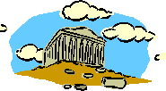
The Golden Age of Athens
-time period of great wealth and culture
(led by Pericles)
-strengthened Athens (built a 200 ship navy)
-developed direct democracy (all citizens help run the government)
-glorified Athens (new buildings of gold, marble, ivory)

Slide 17
Peloponnesian War
war between Athens and Sparta (Spartans resented/jealous of Athens)
Sparta had superior army, Athens had a better navy
Sparta attacked on land and eventually defeated Athens
helped by the Persians and a plague (sickness) in Athens

Slide 18
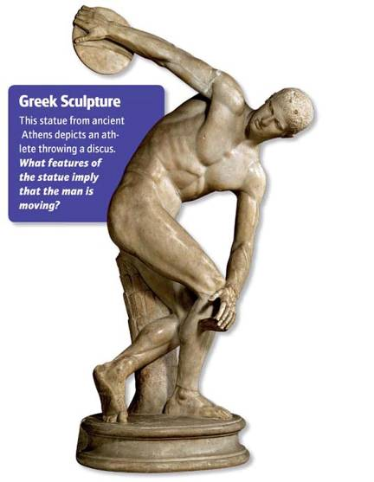
Section 4
The Glory of Greece

Slide 19
Greek Philosophers
great thinkers, thought that there were natural forces in the universe and that gods did not control everything
Socrates – told people to question themselves and life
developed Socratic method of teaching/questioning
executed for corrupting youth of Athens
Plato – student of Socrates
-distrusted democracy
-wanted 3 social classes (philosophers, soldiers, workers)
Aristotle – student of Plato
  -helped create the scientific method

Slide 20
Greek Art and Architecture
- classical – everything is balanced and in order, columns used
(ex. Parthenon p. 133)
-also tried to show everything in its perfect form
- wrote tragedies – plays about suffering using serious topics
-usually had a moral
-also wrote comedies – made fun of people and society
-usually for entertainment but could be used to criticize

Slide 21
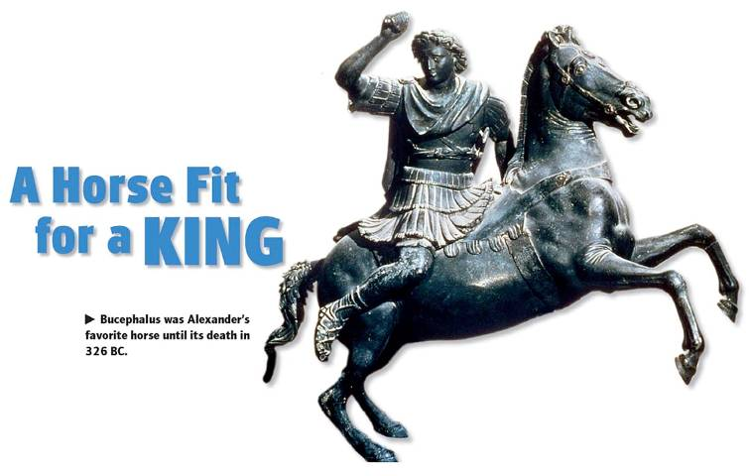
Section 5
Alexander The Great and Hellenistic Culture

Slide 22
Rise of Alexander the Great
-Greece weakened by Peloponnesian war
-invaded and conquered by Macedonia from the north
-led by Phillip II and his son Alexander the Great
-Alexander then takes over all of Persia (p. 138)
-continued into Asia and held a huge empire
-blended cultures of different conquered places and formed
Hellenistic culture – mixing of Greek, Egyptian and Asian
customs

Slide 23
